Slide 1
Introduction to the Suncal software for metrology statistics
Sandia Primary Standards Laboratory
SAND2023-12527O

Slide 2
Course Overview
Suncal Installation and Overview
Uncertainty Propagation
Analysis of Variance
Curve Fitting Uncertainty
Measurement Decision Risk and Guardbanding
Suncal Metrology Calculation Examples

Slide 3
Course Overview
This course is intended to provide hands-on experience using Suncal for metrology calculations.
The following slides contain many example calculations – we won’t have time for all of them.
Most examples come directly from either work done at Sandia’s Primary Standards Lab, or examples solved in various literature such as NIST-TN-1900.
Suggested Examples:
Pitot Tube (GUM and MC Uncertainty)
Magnitude & Phase (GUM-S2/Multiple Outputs)
Contact Resistance (Curve Fitting)
Ball Bearing Acceptance Limits (Decision Risk)
Pressure Gage Drift (ANOVA + Curve Fit + Risk)

Slide 4
Learning Objectives
Participants will be able to use the Suncal software for:
Calculating GUM and Monte Carlo uncertainty propagation
Evaluating and using measured data in uncertainty calculations
Evaluating measurement decision risk
Computing arbitrary curve fits and their uncertainty

Slide 5
Format
This is a hands-on course.
After a little background of each calculation, most of the course will consist of working example statistical metrology calculations using the software.
Specific examples will be selected based on interest of the participants.

Slide 6
Introductions
Name
Organization
Interest in Suncal software or calculation needs

Slide 7
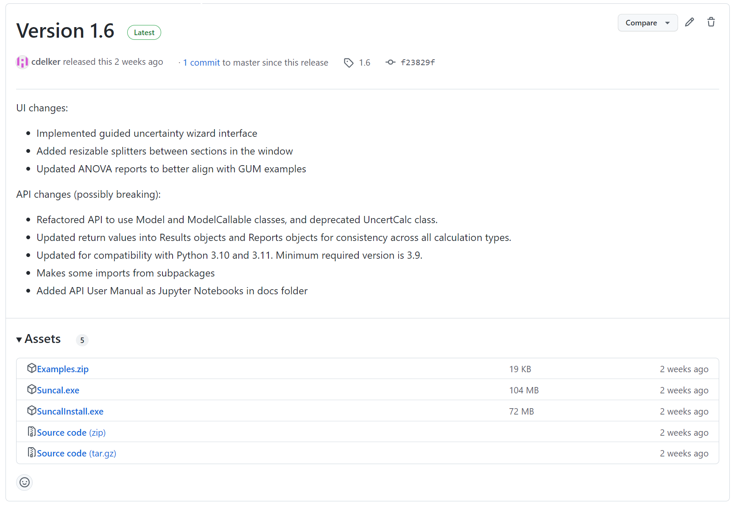
Suncal Software – Desktop Version
Download from: https://sandiapsl.github.io
Windows, Mac, and Linux compatible

Slide 8
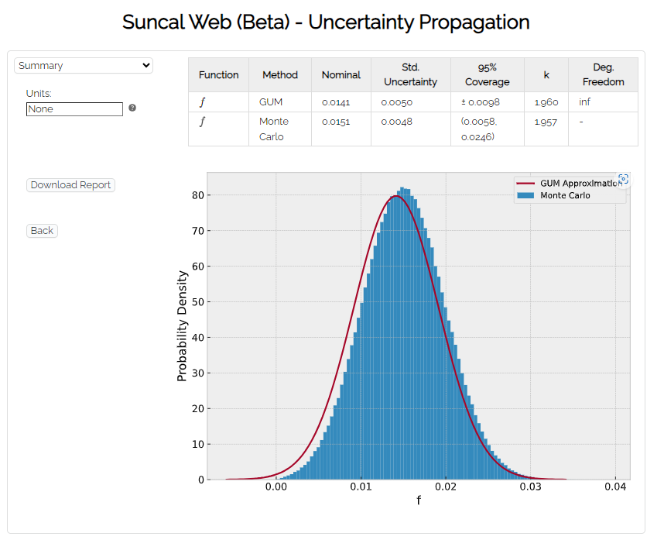
Suncal Software – Web ‘lite’ version
Go to https://sandiapsl.github.io, and click “Web interface to Suncal”
https://sandialabs.github.io/suncal/suncal/uncertainty.html - For Uncertainty Propagation
Calculations run in your browser (no servers see your data)
Same back-end calculations as desktop version
Limited data sharing between “apps”

Slide 9
License
Sandia National Laboratories Uncertainty Calculator (Suncal) is publicly available, open-source software released under the General Public License (GPL).
Free for any commercial or non-commercial use
You may distribute free copies of the code
You may modify the code, but derivatives must also be released under the GPL
The Sandia Uncertainty Calculator is copyright 2019-2023 National Technology & Engineering Solutions of Sandia, LLC (NTESS). Under the terms of contract DE-NA0003525 with NTESS, the U.S. Government retains certain rights in this software.

Slide 10
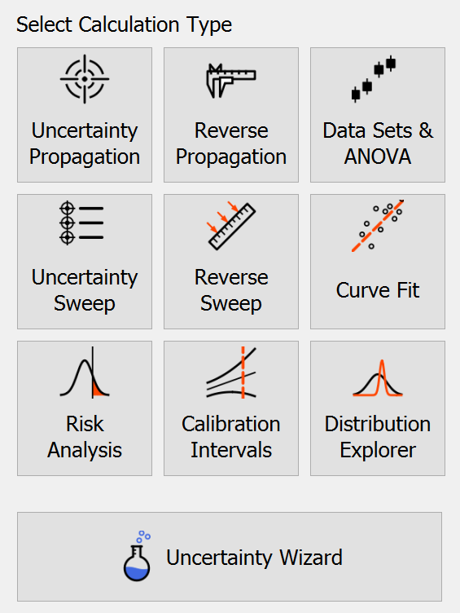
Features Overview
Given: Measurement model, output requirement, need input uncertainty
Use: Reverse Propagation
Given: Measurement model, input values and uncertainties
Use: Uncertainty Propagation
Given: 2-Dimensional data (e.g. N measurements ⨉ M days)
Use: Data Sets and ANOVA
Given: Measurement model, inputs could take several values
Use: Sweeps
Given: (x, y) data, need relationship between x and y
Use: Curve Fit
Given: Probability Distributions and tolerance limits
Use: Risk Analysis
Given: Probability Distributions to visualize (mostly for training)
Use: Distribution Explorer
Guided uncertainty propagation with helpful hints (new in version 1.6)
Given: Historical Calibration Data
Use: Calibration Intervals

Slide 11
Motivation
But what about ________ commercial software that does uncertainty calculations?
While other uncertainty software exists, we found it to be too limiting:
No symbolic solutions to GUM equation
Limited handling of units/dimensional analysis
Limited complexity of model, limited number of input variables
Too much hand-calculation still required (e.g. combining Type A and Type B components)
Limited output reporting
No integration with other metrology calculations (risk, ANOVA, curve-fit, etc.)
No native handling of complex numbers
Limited extensibility
Security

Slide 12
Comparison
Feature | Suncal | Suncal-Web | NIST Uncertainty Machine | GUMSim | GUM Workbench | LNE-MCM
GUM Uncertainty Calculation | ✓ | ✓ | ✓ | ✓ | ✓
Monte Carlo Uncertainty Calculation | ✓ | ✓ | ✓ | ✓ | ✓ | ✓
GUM equations solved symbolically | ✓ | ✓ |  |  | ✓
Joint model PDF outputs (GUM-S2) | ✓ | ✓ |  |  |  | ✓
Units and dimensional analysis | ✓ | ✓ |  | ✓ | ✓
Number of input variables | Unlimited | Unlimited | 15 | ? | 512 | ?
Uncertainty components per variable | Unlimited | Unlimited | 1 | 1 | 1 | 1
Available probability distributions | 90+ | 5 | 8 | ? | 7 | 14
Chaining model functions | ✓ | ✓ |  |  | ✓
GUM Validity Check | ✓ | ✓
Uncertainty sweep calculations | ✓
Reverse uncertainty propagation | ✓
Curve fitting uncertainty | ✓
Loading experimental data | ✓ |  | ✓ | ✓ | ✓ | ✓
Analysis of Variance | ✓
Risk & guardband calculator | ✓ | ✓
Arbitrary code/function uncertainty | ✓ (via Python)
Programming API | ✓ (via Python)
Platform | Windows, Mac, Linux | Web | Web | Windows | Windows | Windows
Cost | Free, GPL | Free, GPL | Free, Closed | $$ | $$$ | Free

Slide 13
Validation
Suncal is compliant with the requirements of Sandia’s Software Quality Assurance Program
Reference:
“Sandia’s Uncertainty Calculator - A case study in the graded approach to software quality assurance”, NCSLI Symposium 2021.
“test” and “docs\Examples” folder from source code

Slide 14
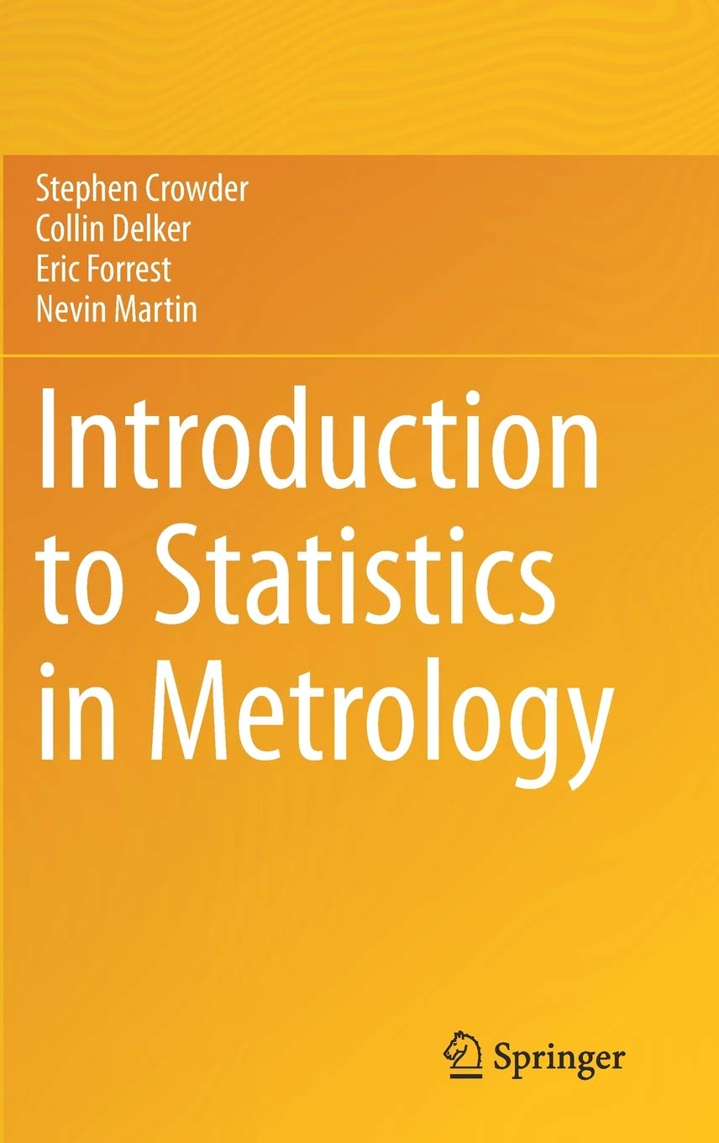
Reference
For details on the theory, math, and statistics used by Suncal:
S. Crowder, C. Delker, E. Forrest, N. Martin. Introduction to Statistics in Metrology. Springer 2020.
Also see:
C. Delker. A comprehensive open-source software for statistical metrology calculations: from uncertainty evaluation to risk analysis. NCSLI Measure, 13-3. (2021)

Slide 15
Uncertainty Propagation

Slide 16
Uncertainty Propagation
How does uncertainty in individual measurements combine to uncertainty in the output?
What we really care about
What we measure
Measurement Model

Slide 17
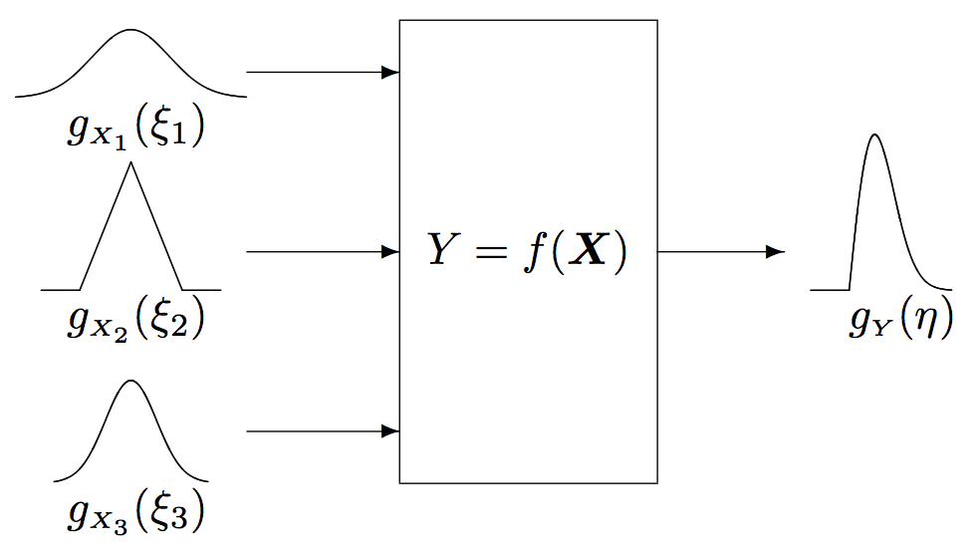
Uncertainty Propagation
How does uncertainty in individual measurements combine to uncertainty in the output?
What we really care about
What we measure
Measurement Model
GUM Approximation:
Monte Carlo:
Disclaimer: Both methods are approximations of the true uncertainty. It is up to the user to analyze the validity of the methods. Suncal provides data that can help.

Slide 18
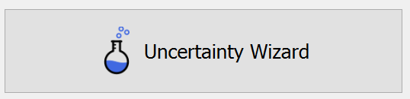
Uncertainty Wizard?
The Uncertainty Wizard provides a more guided, user-friendly interface with help available in the side panel. Limitations:
Single function measurement models
Only uncorrelated Inputs
Only typical probability distributions (normal, uniform, triangular, arcsine)
The Wizard is especially helpful for measurements with Type A data. Import all N measurements and Type A is calculated automatically.

Slide 19
Example: Indirect Resistance Measurement
Measure voltage and current, calculate resistance
Measurement model: R = V / I
What is the uncertainty in resistance?
Parameter | Measured Value Mean | Standard (k=1) Uncertainty of 10 measurements
Voltage | 20.052 V | 0.002 V
Current | 25.321 mA | 0.01 mA

Slide 20
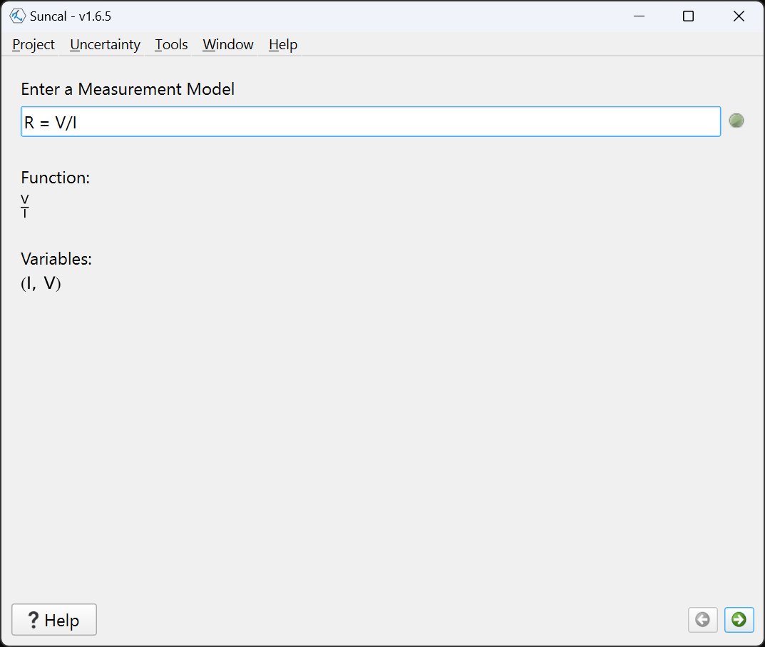
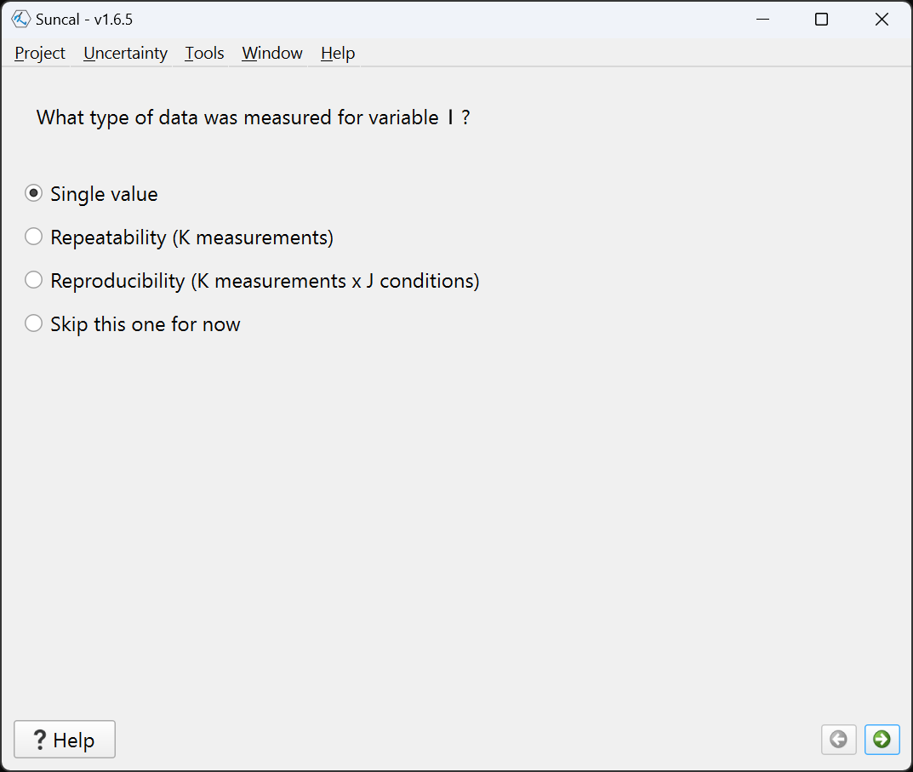
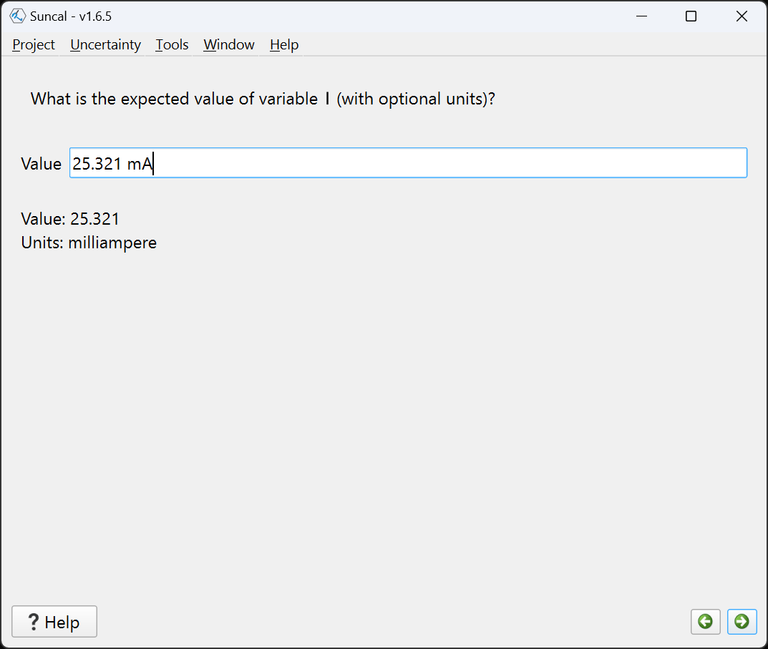
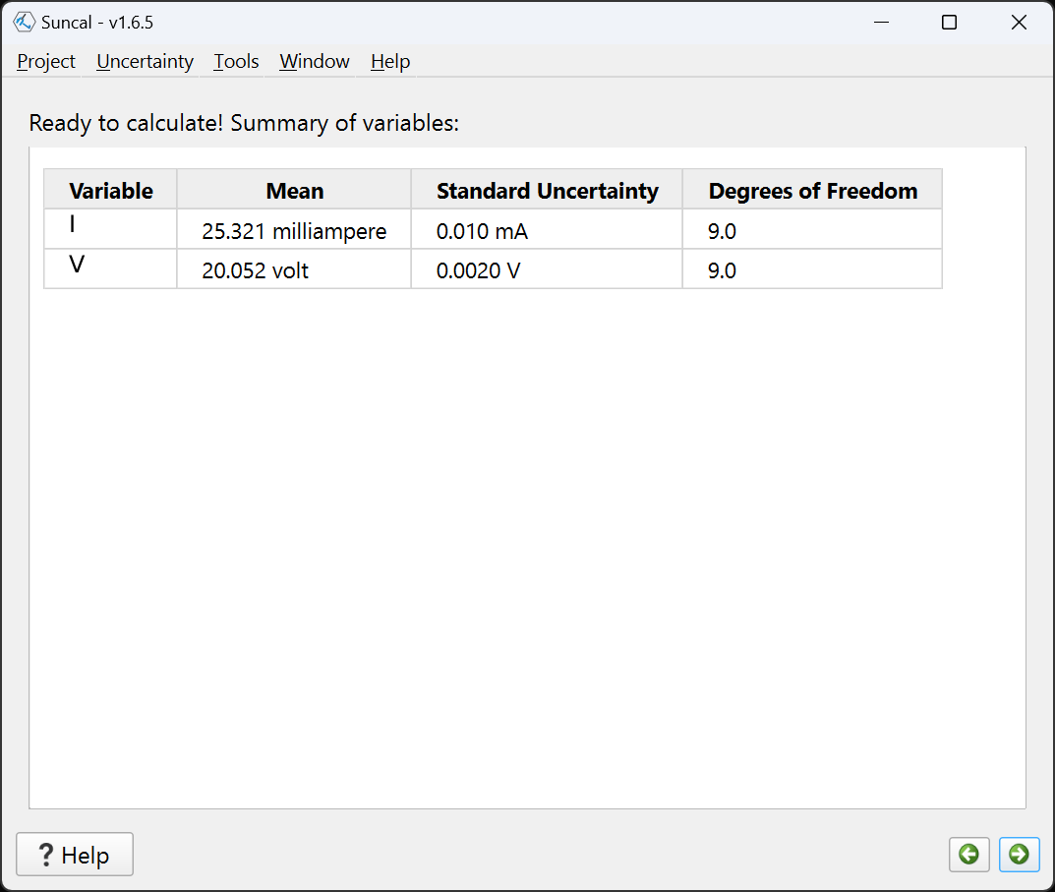
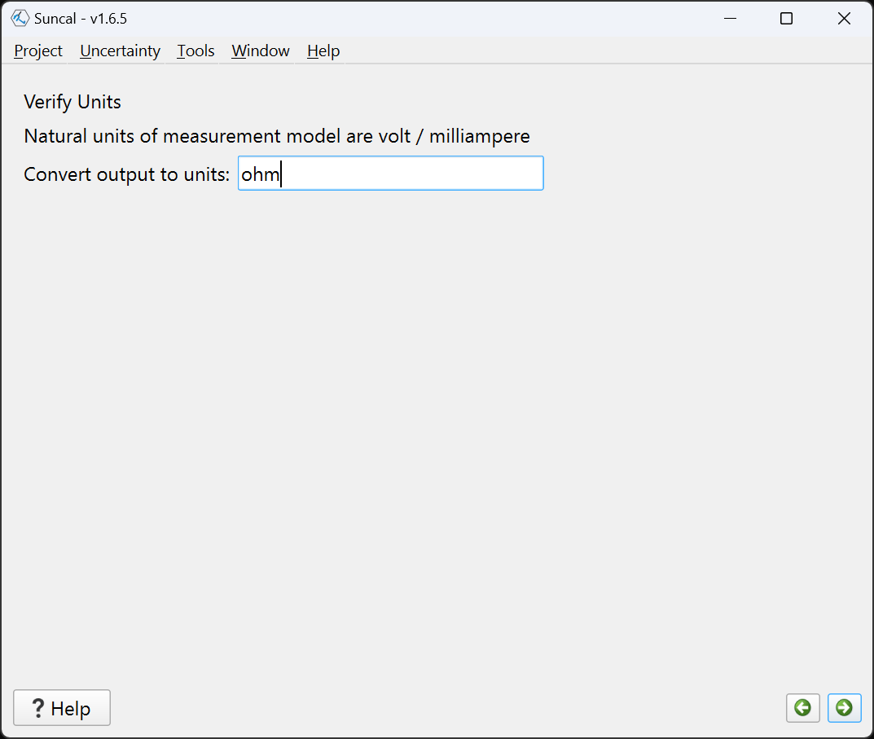
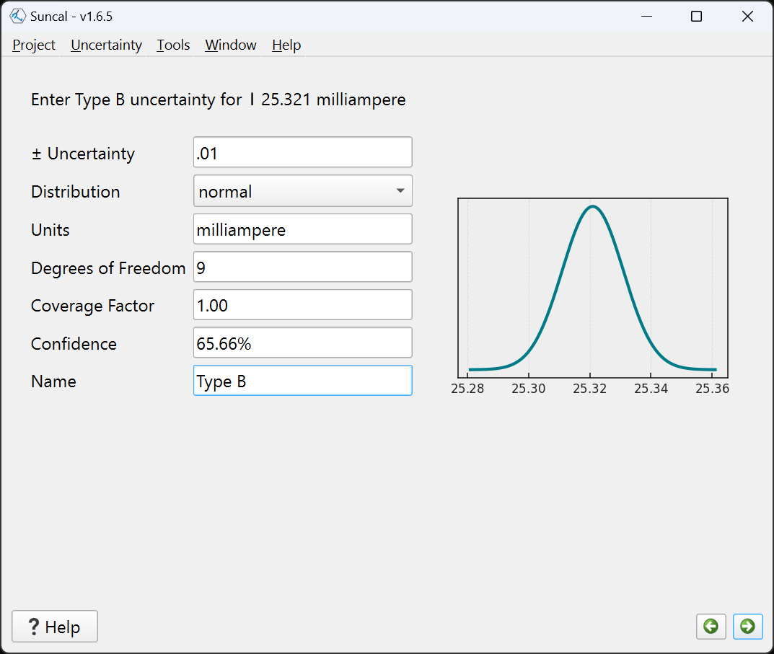
Resistance Measurement – Wizard
Start with measurement model
In this example, each variable is defined by a single number
Enter that number with units
Repeat for Voltage value
Review before calculating
Set units for result
Specify Type B uncertainty

Slide 21
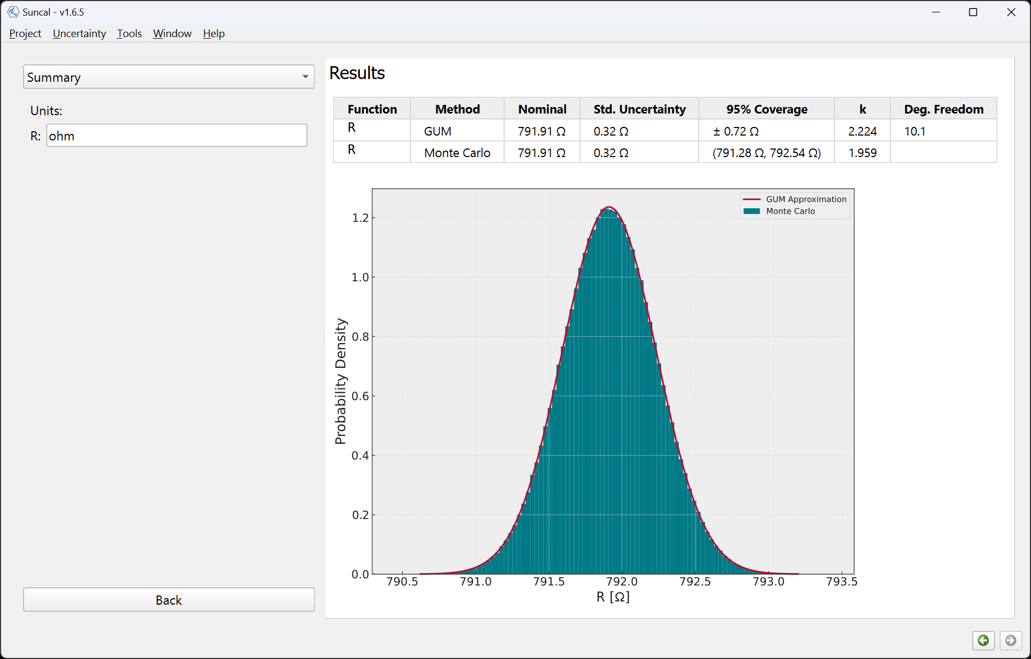
Results
GUM: 791.9 Ω ± 0.72 Ω
MC: 791.9 Ω ± 0.72 Ω
GUM and MC
evaluations agree.

Slide 22
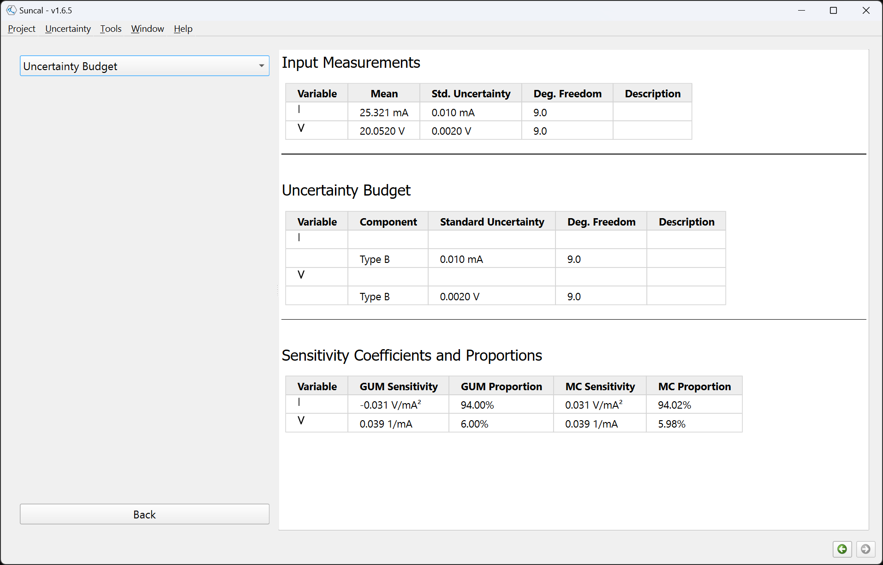
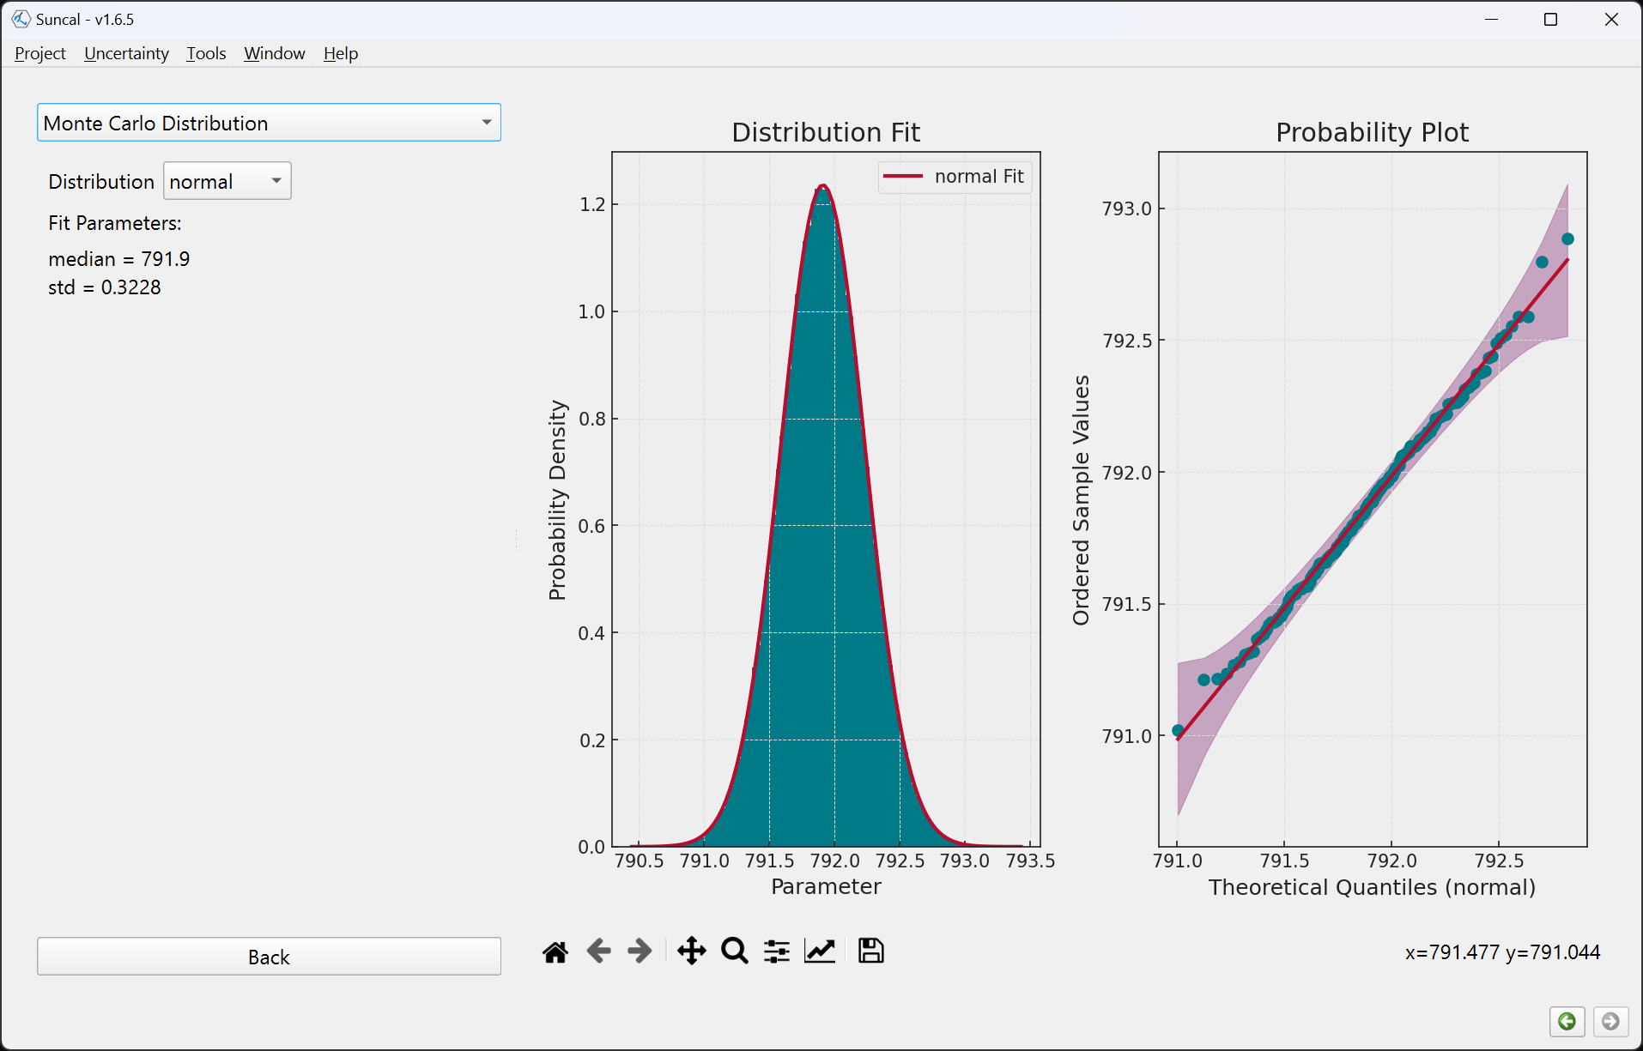
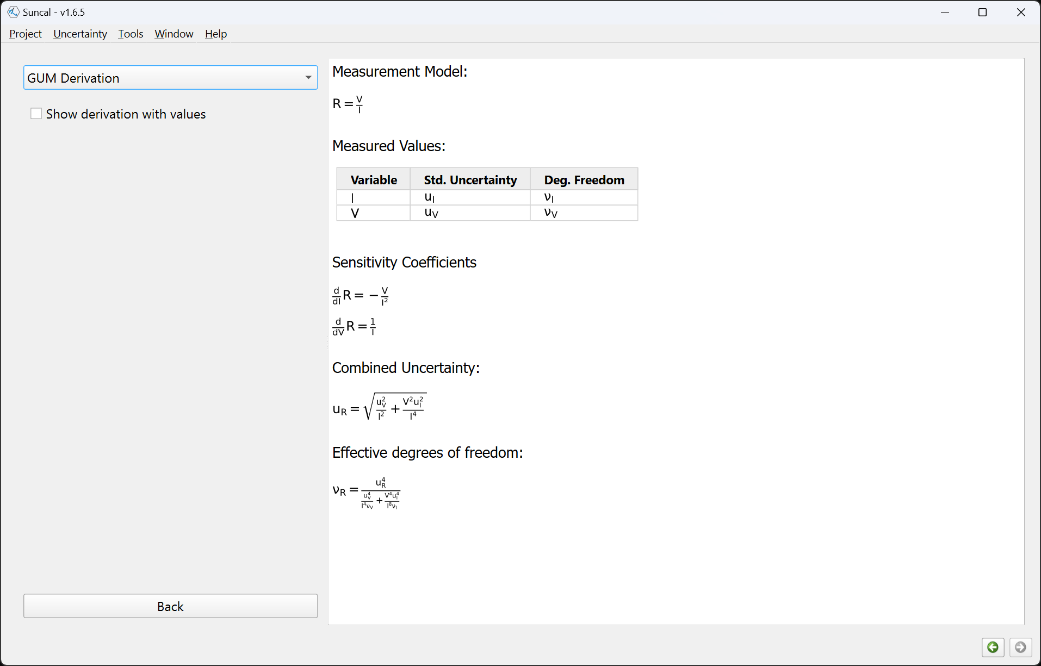
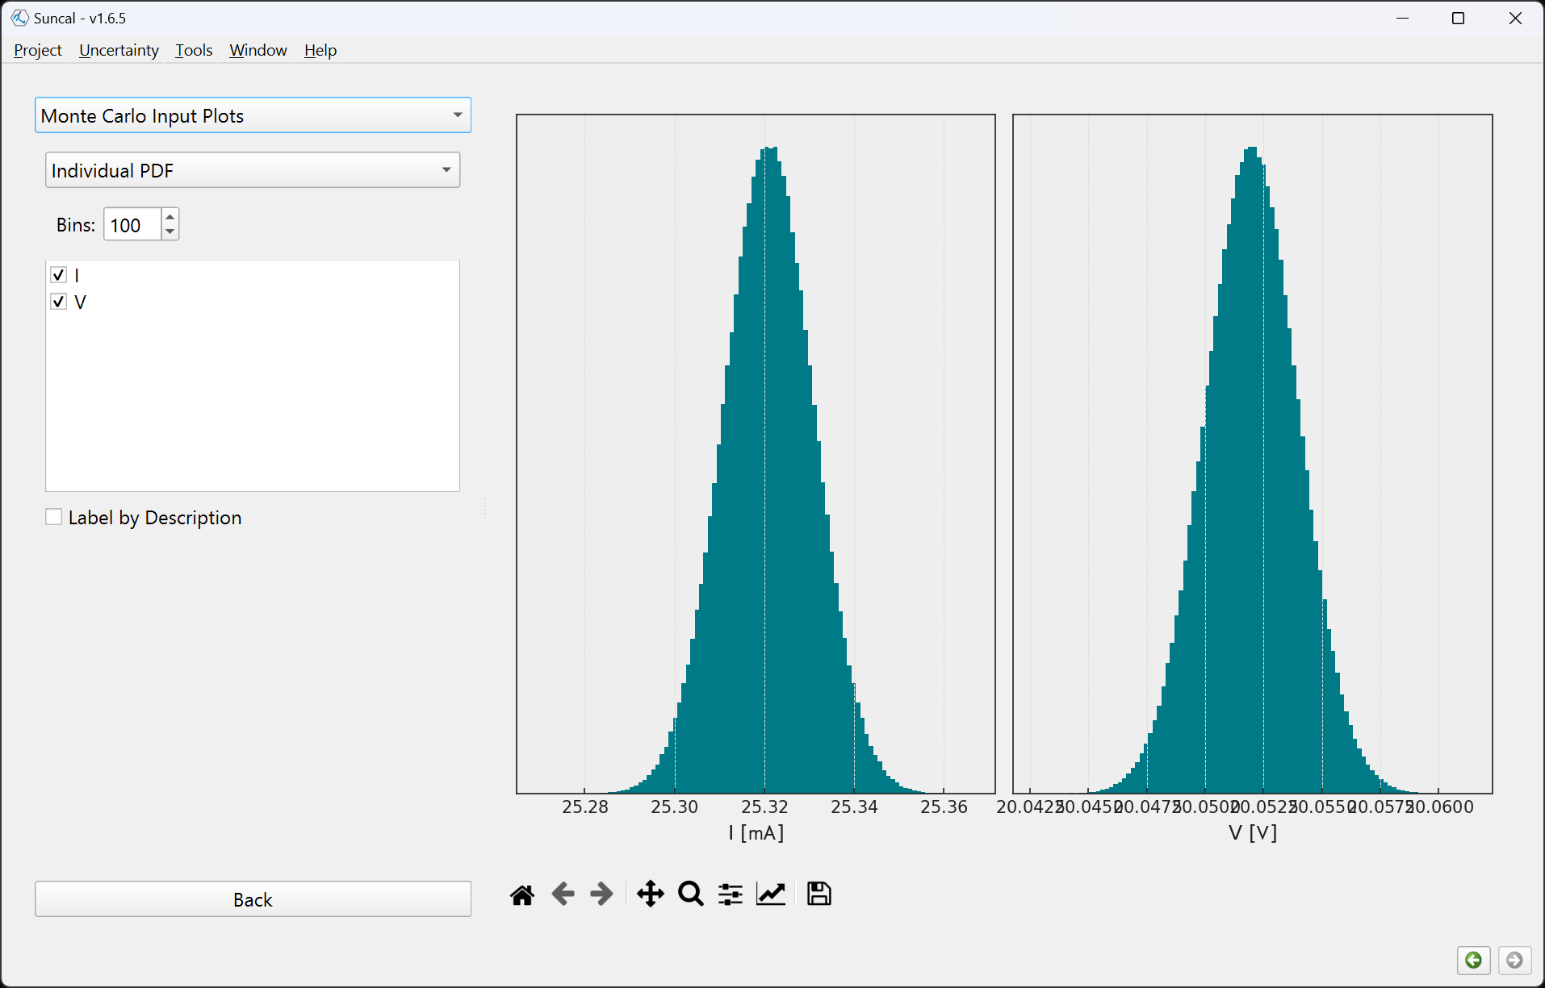
Uncertainty Output Pages

Slide 23
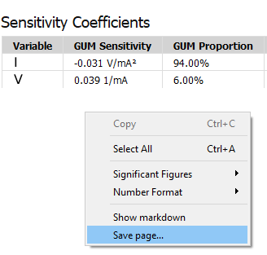
Saving the Output
Text reports: Right-click and Save Page
Plots: Click the disk button
Save everything: Use Project menu.
Save formats:
HTML, Markdown
With Pandoc installed: MS Word, LaTeX source, OpenOffice
With Pandoc + LaTeX installed: PDF

Slide 24
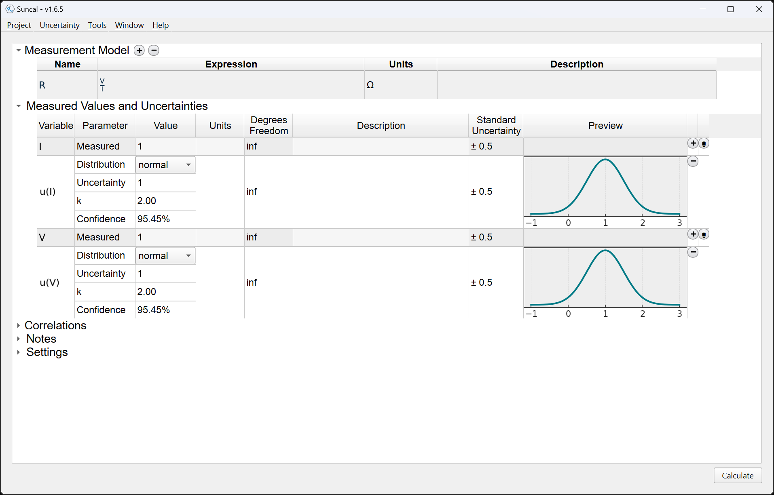
Full Uncertainty Propagation Mode
Enter the Measurement Model “R = V/I”
Enter resistance units “ohm” if desired
Variables are detected and filled in automatically, each with one default uncertainty

Slide 25
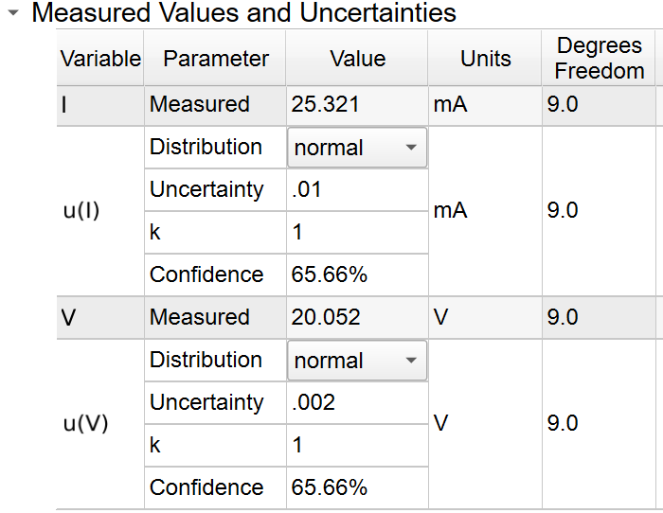
Example: Indirect Resistance Measurement - Setup
Enter the measured voltage and current value and including units on the gray lines.
Most units are recognized by their name or abbreviation.
Enter uncertainties and change coverage factor k to 1 (they were given as standard uncertainties).
Enter 9 degrees of freedom (there were 10 measurements)

Slide 26
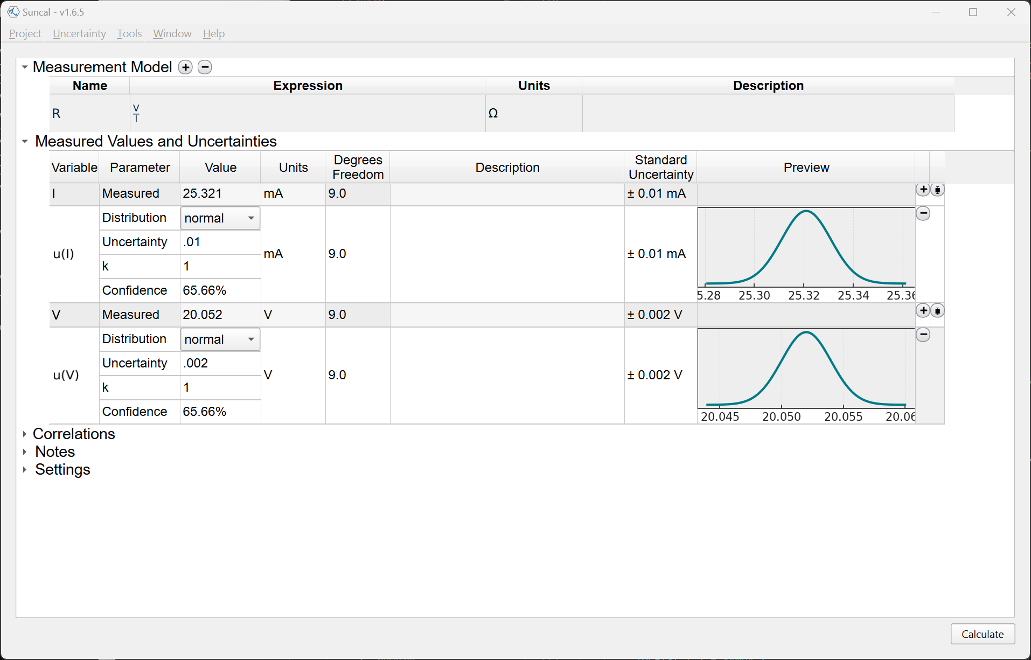
Ready to Calculate

Slide 27
Tips for entering data

Slide 28
Tips for entering variable names
Case Sensitive
“r” is not the same variable as “R”
Subscripts entered using underscores:
“R_1” → R₁
“Q_uut” → Q_{uut}
Names of Greek letters are recognized as variables. Capitalize first letter to get capital Greek letter.
“theta” → θ
“Omega” → Ω
“omega” → ω
“lamda” → λ (Note use “lamda” instead of “lambda” because lambda is a keyword in Python!)
A few values are predefined as constants:
e, pi, inf
Things that are Python keywords can’t be used as variable names:
if, else, def, class, lambda, continue, break…

Slide 29
Tips for entering measurement equations
Typically, use “Excel-like” notation.
Always explicitly multiply with *
a*(b+c) → ok
a(b+c) → not ok
Powers use ^ or **
x^2 → x²
x**3 → x³
Available functions:
sin(x), cos(x), tan(x)
asin(x) acos(x), atan(x), atan2(x, y)
sinh(x), cosh(x), tanh(x), coth(x)
asinh(x), acosh(x), acoth(x)
exp(x), log(x), log10(x)
sqrt(x), root(x, y)
rad(x), deg(x)
Multiple equations can be computed simultaneously on the same input variables. In the same calculator:
R = V/I
P = I*V
Multiple equations can be “chained” together:
R = V/I
τ = R*C
(V, I, and C are measured values, R formula is substituted into τ equation)
But, recursion/circular equations are not allowed:
f = x + y
y = f * g → not ok
Expression will be simplified as much as possible
y * x/x → y (x won’t even show up as a variable)
If it turns red, try again!

Slide 30
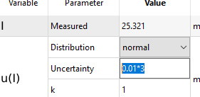
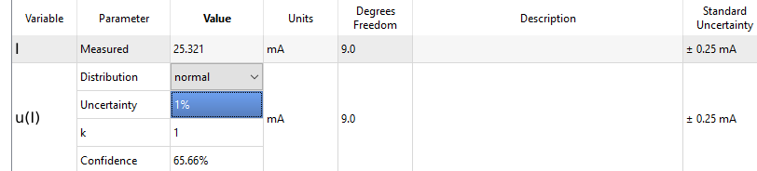
Tips for entering numerical values
Most numeric fields can do basic arithmetic:
Uncertainty parameters understand “%” as percent of the measured value

Slide 31
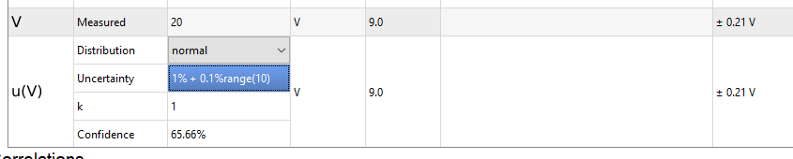
Tips for entering numerical values
Many instrument specs provide uncertainty as “% reading + % range”.
Suncal understands “%range(X)” function: “1%range(100)” calculates to (0.01× 100).
Example: 1% reading + 0.1% range on the 10V range → enter “1% + 0.1%range(10)”
“Reading” is the 20V measured value.
Also available are “ppm”, “ppb”, “ppmrange(X)”, and “ppbrange(X)”
Note ppb is one part in 10⁹.

Slide 32
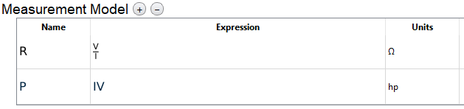
Converting units
The output quantity will be converted to the units entered in the model table.
As an extra test, add a power calculation (P = IV) using the same measured values. Try requesting power in W, mW, J/s, horsepower, etc.
If units are omitted everywhere, everything is treated as dimensionless
If units are included in measured values but not measurement model, the calculation will work but not necessarily provide simplified units (e.g. resistance is given in volts/amp)

Slide 33
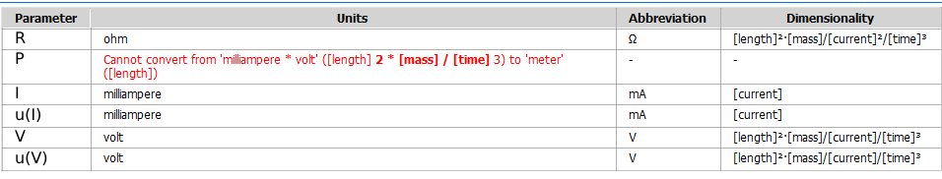
Checking unit compatibility
If entered units are incompatible, an error will be displayed.
Use Check Units from the Uncertainty menu to check for problems.

Slide 34
Tips for entering units
When in doubt, spell it out:
meter
centimeter
centimeter per second
kilopascal
Abbreviations usually work too, including SI prefixes and special characters:
m
cm
cm/s
kPa
kohm, kΩ
Compound/derived units:
psi
pounds per square inch
inHg (one word)
cm^2/V/s
But there are some gotchas:
Capitalization matters
K → Kelvin
k → Boltzmann constant
Possible Confusion:
C → Coulombs
F → Farads
degC, degreeC, or celsius → degrees Celsius
degF, degreeF, or fahrenheit → degrees Fahrenheit
Sometimes need underscores for spaces:
light_year → ok
light year → not ok
Dimensionless units can be left blank. Named dimensionless units (e.g. radians) can still be entered for recordkeeping.
If it turns red, try again!
https://github.com/hgrecco/pint/blob/master/pint/default_en.txt for full list of predefined units!

Slide 35
Temperature Units
What is 25 °C ± 5 °C?
Convert everything to base units: 298.1 K + 278.1 K = 576.2 K = 303.1 °C. → Wait, that’s not right!
The 5 °C is really a differential temperature.
298.1 K + 5 Δ°C = 298.1 K + 5 K = 303.1 K = 30 °C.
The calculator handles absolute and differential temperatures as two different, but related, things.
Differential temperature units are entered and shown as “delta_degC” or “Δcelsius”. Temperature uncertainties are set to delta temperature units automatically. Subtracting two absolute temperatures results in a differential temperature unit.
If you get “ambiguous unit” errors, try changing to “delta_degC” instead of “degC” as a unit.
OR, just use Kelvin for everything. Since it has offset of 0, a differential Kelvin is the same as an absolute Kelvin.

Slide 36
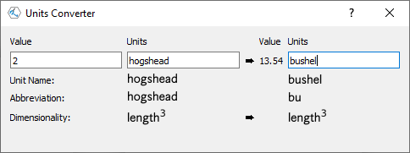
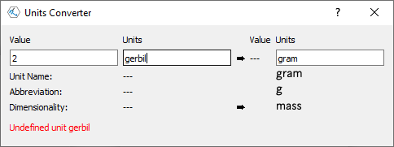
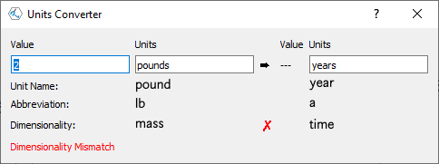
Units Converter
Use Unit Converter from the Window menu to see if a unit name is recognized and to convert values of same dimensionality
Custom units can be defined, based on SI units, in the Preferences menu.

Slide 37
Pitot Tube
Notes:
Kline, McClintock. Describing Uncertainties in Single Sample Experiments. Mechanical Engineering 75.1 (1953)
Demonstrates GUM method and working with different units

Slide 38
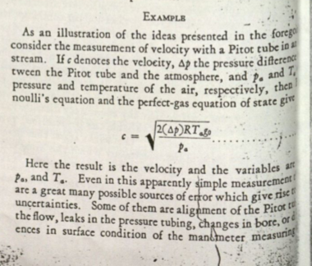
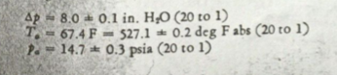
Pitot Tube
The GUM method is based on a 1953 paper by Kline and McClintock, which used the example of a aircraft pitot tube for measuring airspeed.
The paper uses non-SI units, but that’s no problem for Suncal. Also note their use of “20 to 1” confidence, rather than 95%.
See also NIST TN-1900 (which had to convert to SI first)

Slide 39
Pitot Tube
Measurement Equation
Values as given by Kline and McClintock
What is uncertainty in airspeed (velocity)?
Variable | Description | Value | Uncertainty (k=2)
𝝙p | Pressure Differential | 8 in. H₂O | 0.1 in. H₂O
Rs (= Rg₀) | Specific Gas Constant | 287.06 J/K/kg | 0
T_{a} | Ambient Temperature | 67.4 °F | 0.2 °F
p_{a} | Ambient pressure | 14.7 psi | 0.3 psi

Slide 40
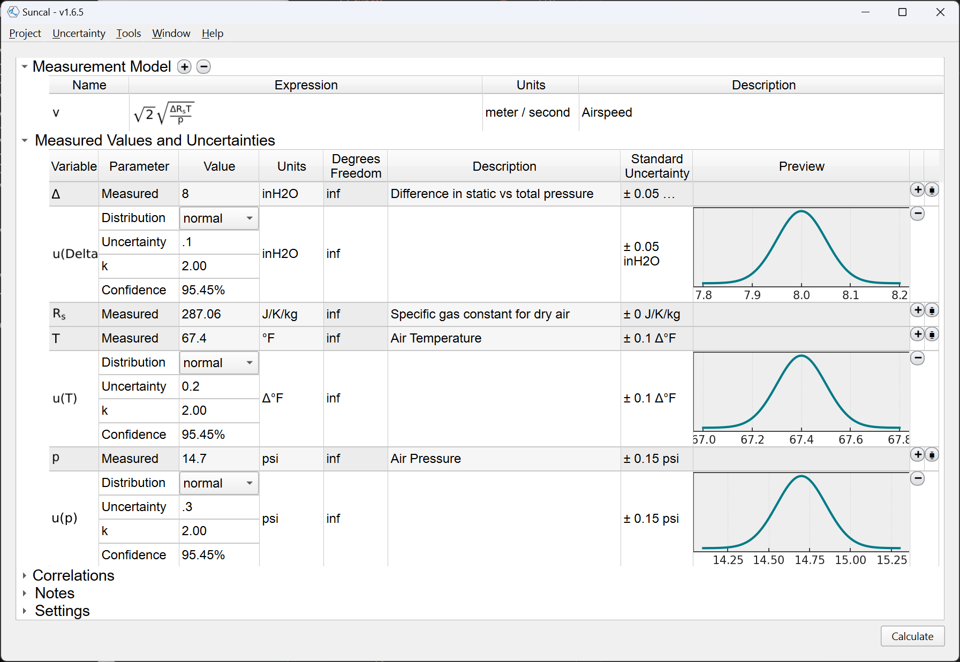
Pitot Tube – Calculation Setup
Notes:
R_{s} has no uncertainty (right-click to remove)
Inches of Water entered as “inH2O”
Temperature in Fahrenheit (“degF”), but uncertainty units are automatically converted to Δ°F.

Slide 41
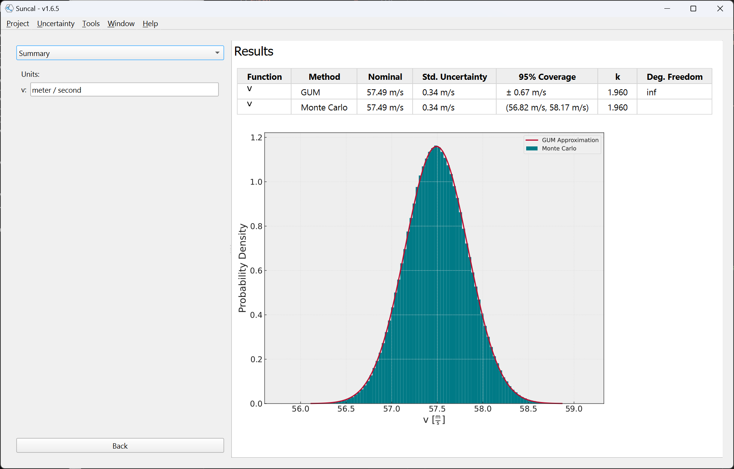
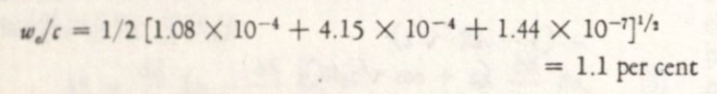
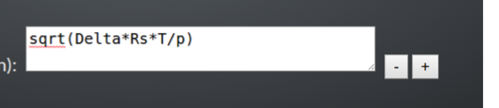
Pitot Tube – Results
Kline-McClintock Paper Results:
Suncal’s Result:
NIST 1900 got it wrong! (They forgot a 2)
* Also try obtaining the output in knots. Most pilots don’t think in terms of m/s.
Notes:
NIST screenshot from NUM course slides at NCSLI Tech Exchange 2017 (taught by Antonio Possolo, author of TN1900)

Slide 42
Circumference of the Earth

Slide 43
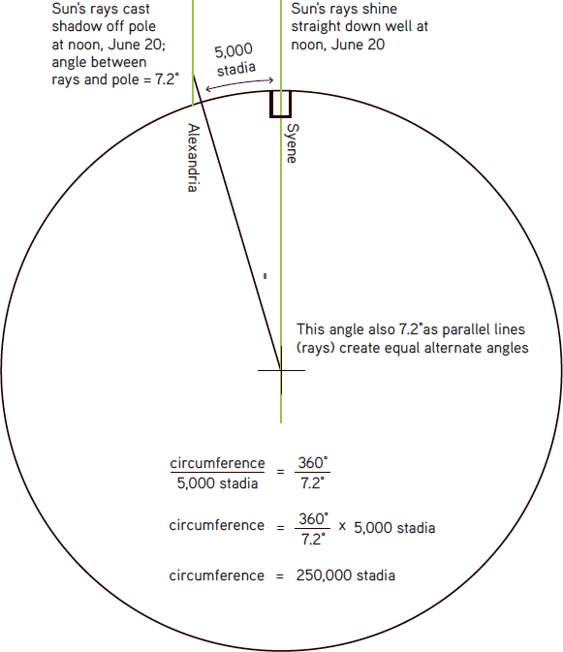
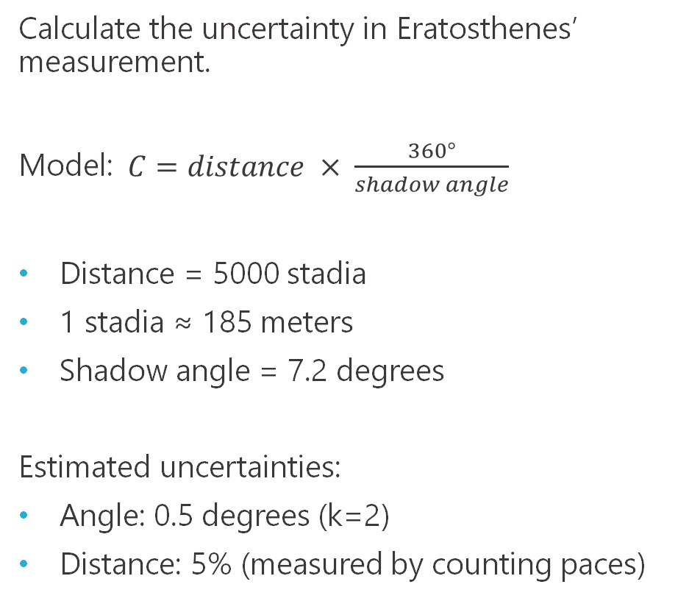
Eratosthenes’ measurement of Earth circumference, c. 200 B.C.E.
Calculate the uncertainty in Eratosthenes’ measurement.
Model: $C=distance × \frac{360°}{shadow angle}$
Distance = 5000 stadia
1 stadia ≈ 185 meters
Shadow angle = 7.2 degrees
Estimated uncertainties:
Angle: 0.5 degrees (k=2)
Distance: 5% (measured by counting paces)
Also see: https://www.youtube.com/watch?v=G8cbIWMv0rI
https://www.khanacademy.org/

Slide 44
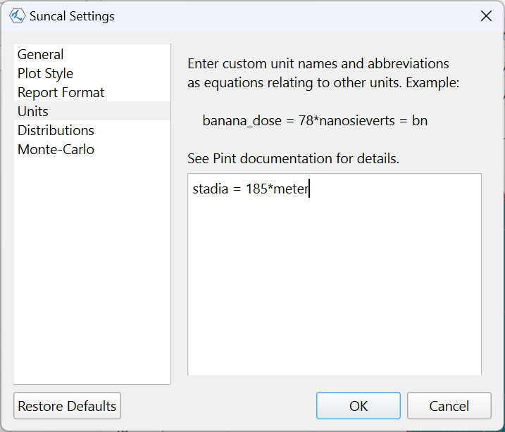
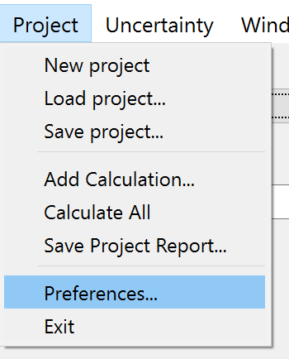
Eratosthenes and Suncal
Problem: Stadia is not a recognized unit. Define it.
* Note the exact conversion from stadia to meters is uncertain. 185 is best estimate, but we are ignoring this uncertainty in the calculation.

Slide 45
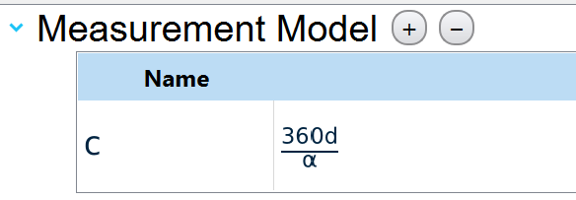
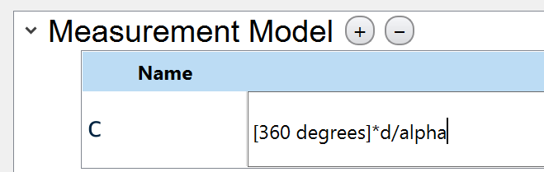
Eratosthenes and Suncal
Problem #2: the 360 parameter has units too. This won’t work if variables have units:
Constant quantities with units may be entered into the model using bracketed values:
[360 degrees]
Notes:
Bracket notation new in version 1.6.1.

Slide 46
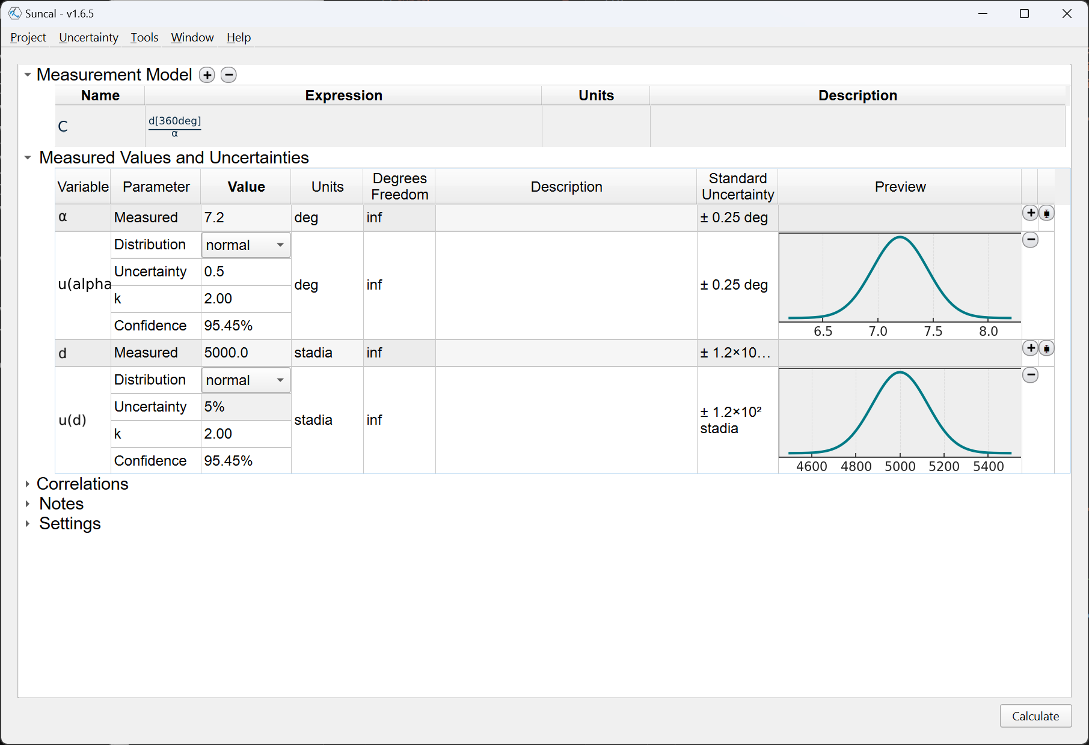
Eratosthenes and Suncal

Slide 47
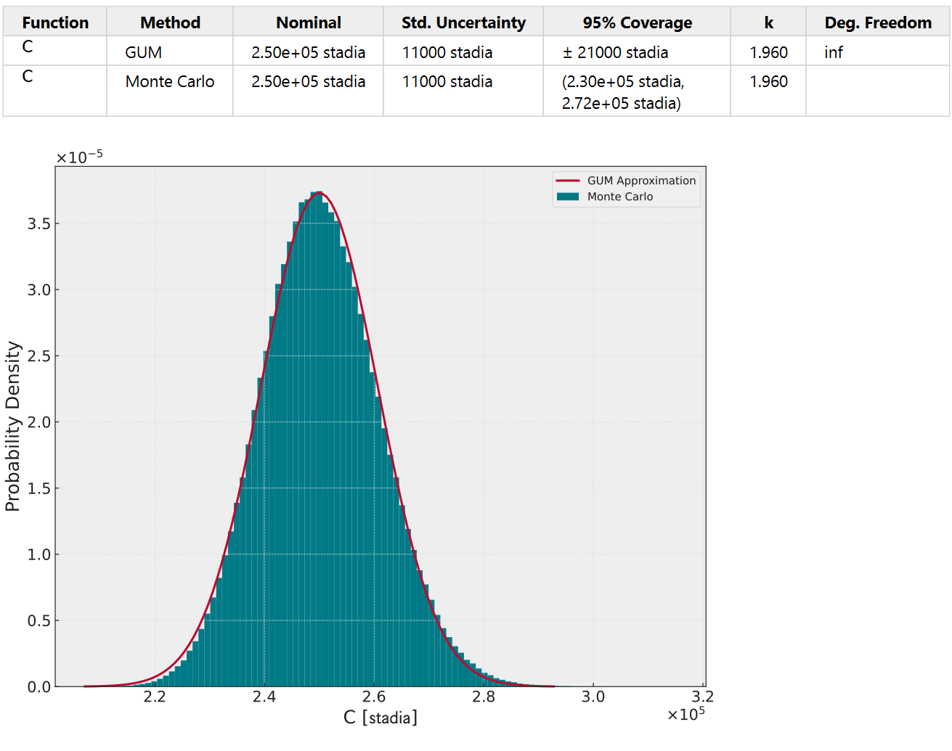
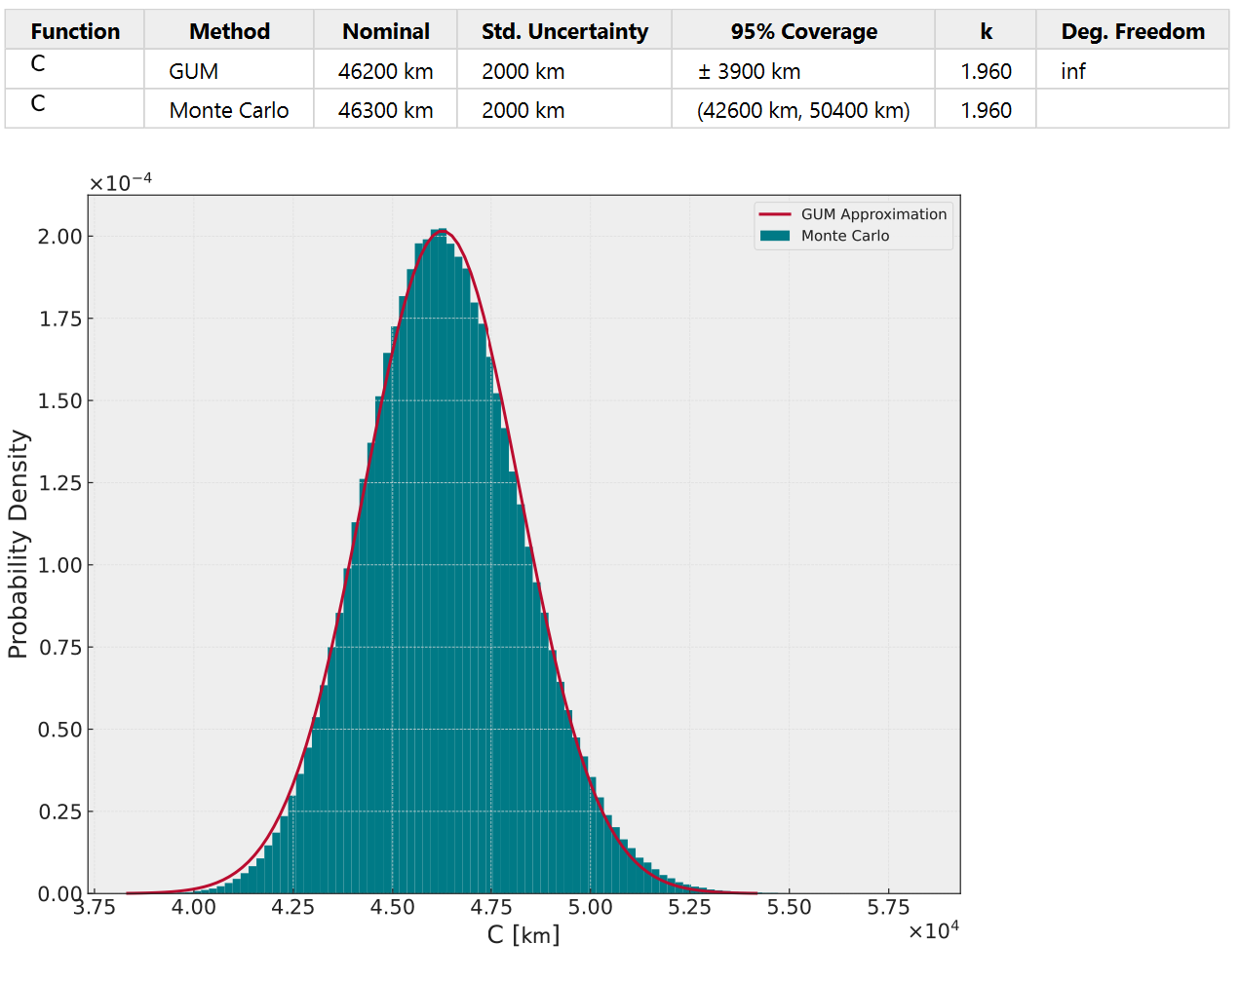
Results – in stadia and kilometers
Modern accepted value for circumference of Earth is 40,075 km
What uncertainties are unaccounted for based on the choice of measurement model?

Slide 48
Neutron Yield Measurement

Slide 49
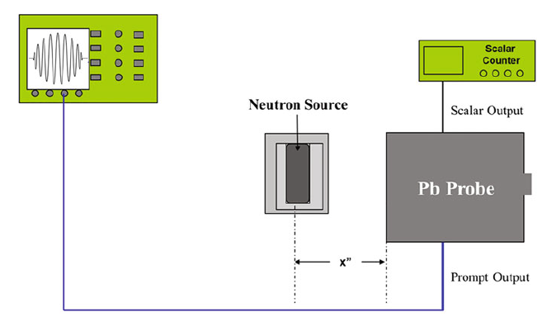
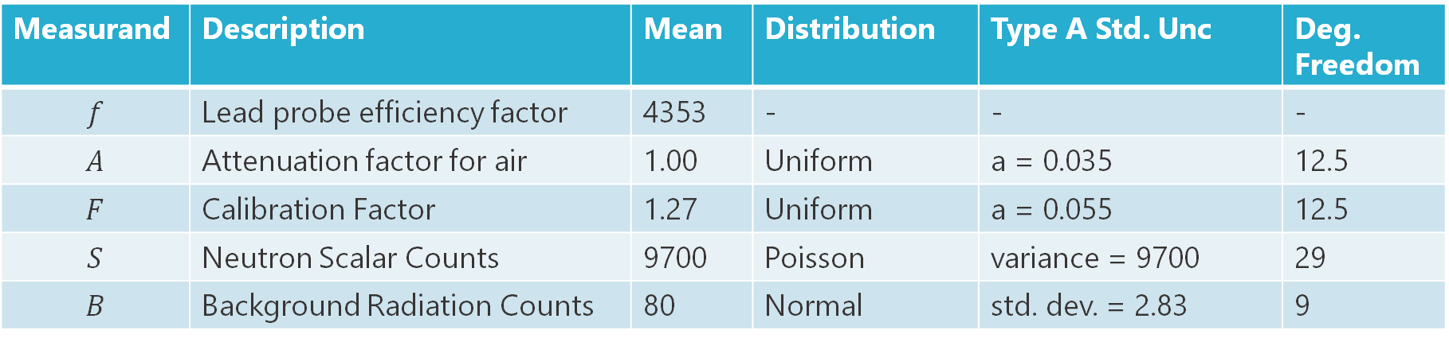
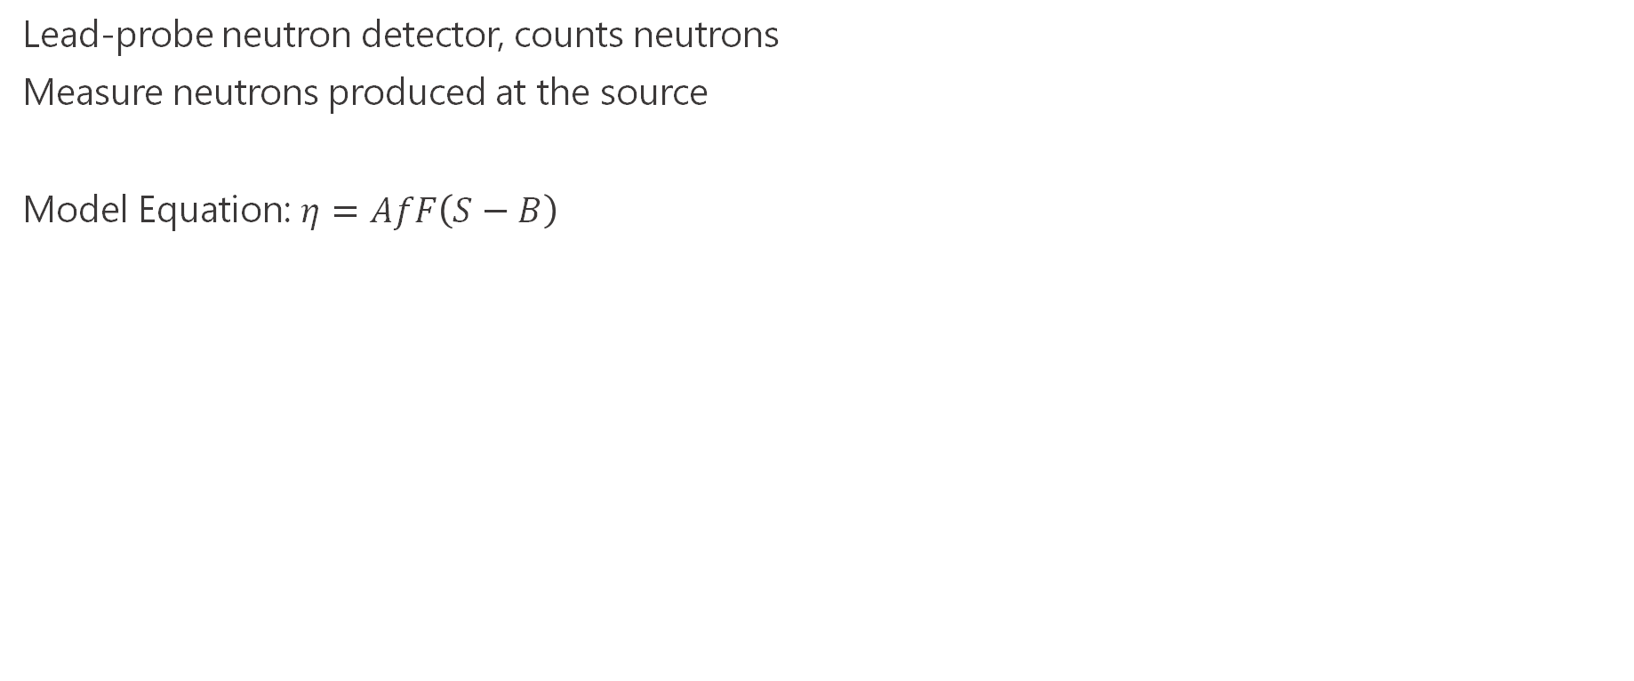
Neutron Yield Measurement
Lead-probe neutron detector, counts neutrons
Measure neutrons produced at the source
Model Equation: $η=AfF\left(S−B\right)$
Measurand | Description | Mean | Distribution | Type A Std. Unc | Deg. Freedom
$$f$$ | Lead probe efficiency factor | 4353 | - | - | -
$$A$$ | Attenuation factor for air | 1.00 | Uniform | a = 0.035 | 12.5
$$F$$ | Calibration Factor | 1.27 | Uniform | a = 0.055 | 12.5
$$S$$ | Neutron Scalar Counts | 9700 | Poisson | variance = 9700 | 29
$$B$$ | Background Radiation Counts | 80 | Normal | std. dev. = 2.83 | 9
Note: Poisson distribution used for discrete counted data. Uncertainty parameter entered as variance (variance = mean)

Slide 50
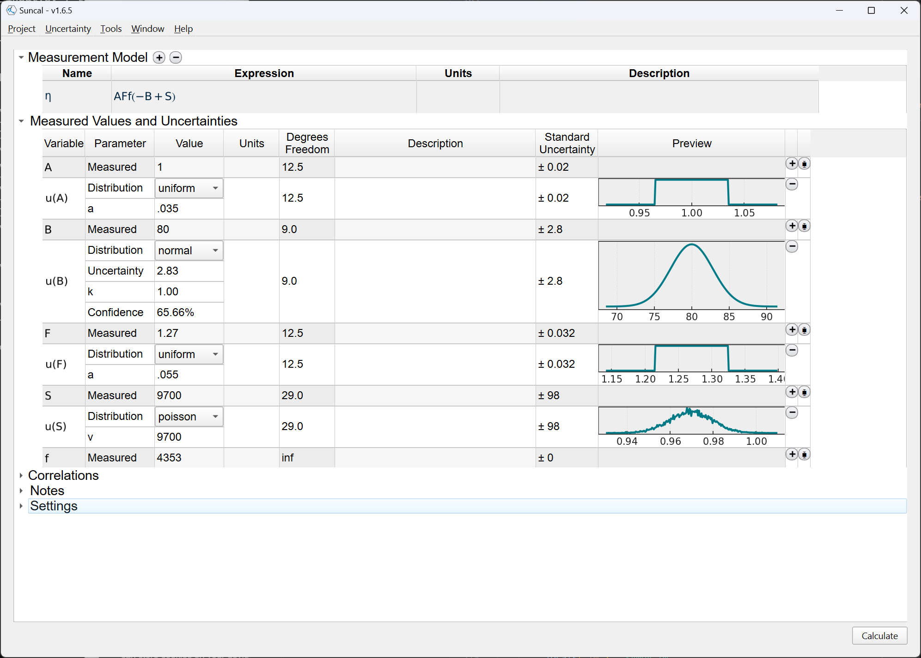
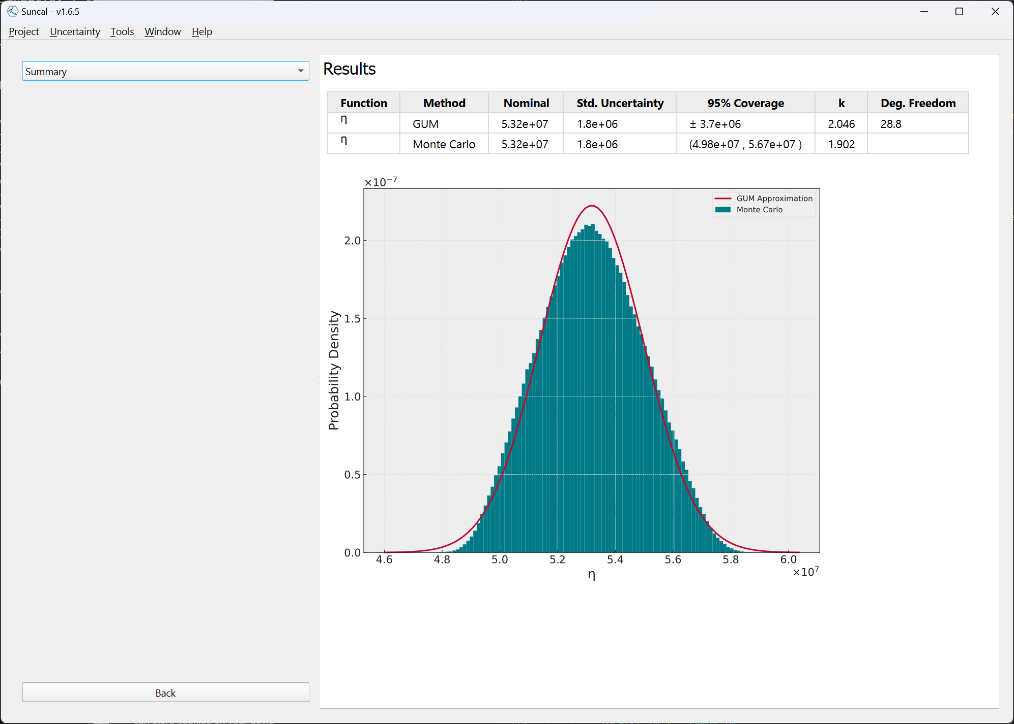
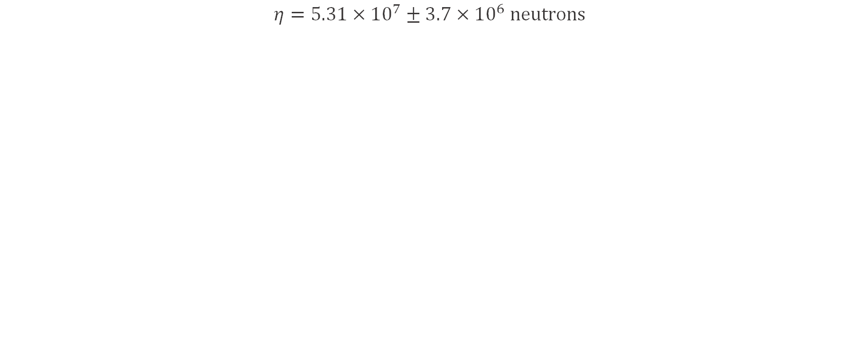
Neutron Yield – Results
$$η=5.31×{10}^{7}±3.7×{10}^{6} neutrons$$

Slide 51
Density of a Cylinder
Notes:
Example from measurement assurance plan at SNL
Uncertainties provided with different units than measurement

Slide 52

Density of a Cylinder
Measure density of a cylinder by measuring mass, height, and diameter. Model:
Measured values, all normal and k=1:
Note the uncertainty units are different from measurand units (not uncommon for a calibration to be done in SI, but customer uses imperial)
What is the cylinder density, in g/cm³, and its uncertainty at 95%?
Is the GUM a good approximation of uncertainty?
Variable | Measured Value | Uncertainty
$$m$$ | 5.0 g | 10 mg
$$h$$ | 0.20 inch | 500 µm
$$d$$ | 0.75 inch | 500 µm

Slide 53

Density of a Cylinder – Setup
Notes:
Uncertainty units are different from measured value units
ρ symbol entered by typing “rho”
Micrometers entered as “um”, “micrometer” or “μm” if you know how to type a µ symbol (ALT+230 on Windows)

Slide 54

Density of a Cylinder – Results

Slide 55
Direct Voltage Measurement

Slide 56


Direct Voltage Measurement – Using Wizard
Keysight 3458A Uncertainty Components – measuring a 5 mV DC output
No measurement model since this is a direct measurement. f(V) = V
Three uncertainties:
Type A repeated measurements
Manufacturer’s Accuracy
Resolution
Notes:
Direct measurements f(x) = x
Combining multiple uncertainty components (type A and type B)
Interpreting manufacturer specs, using %reading + %range

Slide 57



Uncertainty #1 – Type A uncertainties
Type A uncertainties are entered in the wizard by selecting “Repeatability” (for 1-D measurements) or “Reproducibility” (for 2-D measurements)
100 measurements were made and stored in “voltage_typeA.csv”. Open the CSV file, copy/paste the values into Suncal.
Type A Uncertainty (Standard error of the mean) is calculated automatically

Slide 58


Uncertainty #2 – Equipment Accuracy
From data sheet 1-year spec 100mV range: 9 ppm reading + 3 ppm range, given as 95% (k=2) values
Add a Type B uncertainty.
Use ppm and ppmrange(0.1) for easy entry

Slide 59


Uncertainty #3 – Resolution
10 nV resolution on digital display
Change distribution to “resolution” – a fancy way of setting up a uniform
Set units to nV

Slide 60

Direct Measurement – Ready to calculate

Slide 61

Direct Voltage Measurement – Results
Calculate to combine the three uncertainty components

Slide 62
RC Circuit Time Constant

Slide 63

Resistor-Capacitor Circuit Time Constant
Resistor-Capacitor circuits are to be constructed from 1 resistor and two parallel capacitors. Capacitors use manufacturer specs, resistor is measured with a DMM.
Component | Measured Value | Type A Uncertainty | Type B (DMM) Uncertainty (95%)
R | 32 kΩ | 12.0 Ω, k=1, ν=9 | 0.01% reading + 0.001% range (100kΩ)
Component | Value | Manufacturer Tolerance
C1 | 0.1 µF | ± 0.005 µF
C2 | 0.22 µF | ± 0.01 µF

Slide 64


RC Circuit Time Constant
Enter the uncertainties as uniform distributions because we don’t know the confidence of the manufacturer specs.
Note the difference between GUM and Monte Carlo methods.

Slide 65
Pipe Organ

Slide 66

Pipe organ
The frequency of a (open-ended) vibrating column of air is $f=\frac{v}{2L}$ where v is the velocity of sound in air and L is the length of pipe.
Given the velocity of air is (345.24 ± 0.5) m/s (corresponding to approximately 22-24 ºC), what tolerance is required on the length of pipe to achieve 440 Hz with less than ±1.3 Hz variation in frequency (the minimum human-perceptible difference, according to NIST).
Notes:
https://www.nist.gov/pml/time-and-frequency-division/popular-links/time-frequency-z

Slide 67


Pipe organ
Solving for uncertainty of an input variable – use Reverse Propagation.
Value of L will be solved for. These entries are ignored.
Enter reverse target: Solve for L, target (frequency) value of 440 with 1.3 uncertainty.

Slide 68

Pipe organ – Results

Slide 69
Acoustic Chamber

Slide 70

Acoustic Chamber – to measure infrasonic pressure
c = sensor calibration constant Pa/V
g = Ratio of specific heats 1.4 [unitless], no uncertainty
P₀ = Ambient pressure 83.5 kPa ± 0.08 kPa
A = Speaker area 386 cm² ± 0.1 cm²
S = Speaker displacement 2.3 cm ± 25 µm
r = Voltage 40 V, no uncertainty
V₀ = Chamber volume 1.419 m³ ± 0.016 m³
*E. O’Brien, et. al. Acoustic Chamber Characterization. NCSLI Symposium, Cleveland OH, 2019.

Slide 71


Slide 72

Acoustic Chamber – Results
Conference talk (hand-calculated GUM):
0.02 Pa/V
Results check out!

Slide 73
Leak Rate
Notes:
Credit Samuel Maldonado, PSL Leaks Lab

Slide 74
Leak rate measured using comparison method
Variable | Description | Measured | Uncertainty (k=2)
(Q_{He})_{uuT} | Leakage rate of UUT at test temperature T [cm³/s] | Calculate Me | Calculate Me
(Q_{He})_{stdcal} | Leakage rate of standard at temperature T_{cal} | 1.539 x 10⁻⁶ cm³/s @ STP | 2%
T | Temperature of UUT during calibration | 23.8 °C | 0.1 °C
T_{cal} | Calibration temperature of standard | 26.67 °C | 0.1 °C
⍺ | Temperature coefficient of standard leak rate | 0.03 1/°C | 0.0005 1/°C
H_{uut} | Detector reading corresponding to amount of gas detected from UUT | 2.0 V | 0.001% reading + 0.01% range (10V)
H_{std} | Detector reading corresponding to amount of gas detected from standard | 3.0 V
H_{bkg} | Detector reading corresponding to amount of gas detected when leaks are isolated | -0.02 V
74

Slide 75

Leak Rate – Check Units

Slide 76

Leak Rate – Results

Slide 77

Leak Rate – Uncertainty Budget
Check the Uncertainty Budget output for sensitivity coefficients and proportions
Most of the uncertainty is from Qstd!

Slide 78



Advanced Topic: Repeat at different temperatures
The leak measurement is performed at 18°C, 23°C, and 28°C. You could run the previous calculation 3 times, OR set it up as a sweep.
1) Turn calculation into sweep
2) Specify parameter(s) to sweep
3) Enter values for each sweep point

Slide 79

Leak Rate Temperature Sweep – Results
Leak rate and uncertainty is calculated at each temperature point

Slide 80
Magnitude and Phase

Slide 81

Magnitude and Phase conversion from Real and Imaginary
See GUM Supplement 2
A complex quantity is measured in real and imaginary components, then converted to magnitude and phase. What are the uncertainties in magnitude and phase and how are they correlated?
Magnitude $A= \sqrt{im^{2}+re^{2}}$
Phase $θ= \tan^{−1}{\frac{im}{re}}$
Parameter | Measurement | Std. Dev.
Real Part | 0.01 | 0.01
Imaginary Part | 0.0 | 0.01

Slide 82

Magnitude and Phase
Enter the measurement model as two equations, and enter the measured values. The two equations share input variables re and im. Run the calculation.

Slide 83

Magnitude and Phase
Switch to Comparison Plots. Choose Joint PDF and Contours to compare magnitude vs. phase uncertainty. This allows observation of correlations between output parameters.
Figure should appear similar to Figure 17 in GUM-S2.

Slide 84

Magnitude and Phase
Now go back and add a correlation. Expand the Correlations section and right-click to enter a correlation coefficient of 0.9 between re and im. Recalculate.

Slide 85

Magnitude and Phase
Results should appear similar to Figure 20 in GUM-S2. Experiment with other values for re and correlation.

Slide 86

Magnitude and Phase – Sweeping Multiple Values
The GUM-S2 plots the results using several different values for re. The calculator makes it easy to make these plots all at once. Keeping the same window from the last example, go to the Uncertainty menu and select New Uncertainty Sweep… A new Sweep section will be shown.

Slide 87

Magnitude and Phase – Sweeping Multiple Values
Add a new sweep by right clicking and Add Sweep Column. Select Mean and re as the sweep parameters. In the table, enter re values of 0.001, 0.002, 0.005, 0.01, 0.02, 0.05, 0.1, 0.2, and 0.5.

Slide 88

Magnitude and Phase – Sweeping Multiple Values
After calculating, return to Comparison Plots. Use the new slider to review results of the different re values.

Slide 89


Magnitude and Phase – Sweeping Multiple Values
Go back, and remove the sweep (right-click menu). Add a new sweep, this time selecting Correlation between re and im. Use the Fill Column right-click option to enter a range from 0.1 to 0.9. Recalculate and view the results.

Slide 90
Gage Ball Density (Reverse Uncertainty)

Slide 91


Gage Ball Density
The density of a gage ball is determined from the measurement model:
$$ρ= \frac{6m}{πd^{3}}$$
The density must be calibrated to an uncertainty of 0.02 g/cm³ (k = 1)
The available equipment can measure diameter with (k=1) uncertainty of ± 5 μm
How good must the mass measurement be in order to meet the density uncertainty requirement?
Nominal diameter: 22.225 mm
Nominal mass: 86.030 g
Nominal density: 14.967 g/cm³

Slide 92


Gage Ball Density
We need to calculate the uncertainty in one of the model input values, so this is a reverse uncertainty problem. Set up a new Reverse Uncertainty calculation in the program. Enter the measurement model and nominal values for d and m.
$ρ=\frac{6m}{πd^{3}}$
In the Reverse Target Value section, enter the target density value (14.967) and uncertainty (0.02). Then select m as the variable to solve for.

Slide 93

Gage Ball Density
Run the calculation to get the required mass and mass uncertainty. Here, we require a mass measurement of 86,032 mg with k = 1 uncertainty less than 99 mg. Both GUM and Monte Carlo results are shown.
GUM method simply does the algebra to reverse the uncertainty expression.
MC method solves the model for the desired input variable and performs MC on the reversed model, but also must account for estimated correlation between all the parameters.

Slide 94
Gage Ball Density – Sweep
It was decided to outsource the gage ball calibration. A calibration provider must be selected which can meet the density uncertainty requirement of 0.02 g/cm³ (k = 1).
The provider must meet two uncertainty requirements, density and mass, but the relative contributions don’t matter, only the required uncertainty in total density is of concern.
This problem can be approached using a reverse uncertainty sweep. Sweep over a range of density uncertainties, and solve the reverse problem for mass uncertainty at each point.

Slide 95


Gage Ball Density – Sweep
Without closing the program from the previous problem, select New Uncertainty Sweep… from the Uncertainty menu. Now a Sweep section will be shown along with the Reverse Target section. Use the + button to add a sweep of diameter uncertainty, then right click and Fill Column to enter a range from 1 to 9 microns (remember these are k = 1).

Slide 96

Gage Ball Density – Sweep
Calculate the results. Any calibration provider whose combination of mass and diameter uncertainties (k = 1) falls under the curve will meet the density uncertainty requirement.

Slide 97
Curve Fitting with Uncertainties

Slide 98

Curve Fit Methods
Curve Fit Method depends on available data and uncertainties:
Straight Line fit with uncertainty in y: linefit algorithm from Numerical Recipes in C (Press 2002)
Straight Line fit with uncertainty in x and y: York’s line fit algorithm (York 2004)
Nonlinear fit, uncertainty in y: curve_fit method in Scipy package (Levenberg-Marquardt algorithm)
Nonlinear fit, uncertainty in x and y: Orthogonal Distance Regression, Scipy package
Markov-Chain Monte Carlo (see Elster 2011). Requires constant u(y) and no u(x).

Slide 99

Curve Fit Uncertainty
Four methods for propagating uncertainty in the curve fit.
Least Squares Analytical
Monte Carlo
Markov-Chain Monte Carlo
GUM
Typically use Least Squares Analytical or MCMC (see Elster 2011). Others are mostly for comparison/experiment.

Slide 100
Temperature Coefficient of Resistance

Slide 101
Temperature Coefficient
Temperature (°C) | Resistance (Ω)
16.189 | 200.0417
17.260 | 200.0433
18.332 | 200.0454
19.339 | 200.0478
20.426 | 200.0491
21.411 | 200.0513
22.413 | 200.0536
23.493 | 200.0548
24.527 | 200.0565
25.536 | 200.0580
26.554 | 200.0594
27.591 | 200.0605
28.631 | 200.0616
29.698 | 200.0626
The RF bridge resistance in HP/Keysight 432A power meters shows temperature variation in resistance
432A was placed in air bath and resistance measured over range from ~ 16°C to 29°C
Data in 432A-TCR.csv
Develop a model to predict resistance and its uncertainty at any operating temperature

Slide 102




Temperature Coefficient
Start a Curve Fit calculation.
Data can be entered in the table directly, copy/pasted, or loaded from CSV file using the menu.
Uncertainties can be entered in the table if known (make sure they account for all sources of uncertainty in the data).
In this example, we don’t know what fit model to use, so start with Line.

Slide 103

Temperature Coefficient
Press Calculate to see the results.
Curve parameters and uncertainties
Full equation

Slide 104

Temperature Coefficient
Examine the Residuals output to verify the model
The residuals aren’t random above and below the mean, indicating another model may be more suitable for this data

Slide 105


Temperature Coefficient
Go back and change the Function to Polynomial with order 2. Then recalculate.
This model appears to be a much better fit.

Slide 106

Temperature Coefficient
Use Prediction to predict the resistance and its uncertainty at any temperature.

Slide 107

Temperature Coefficient
If you’d prefer just expanding the uncertainty to cover all possible temperatures, use Interval.
Uses GUM F.2.4.5 to find a 95% uncertainty that covers the entire range of temperatures.
See: Delker, Auden, and Solomon. Calculating Interval Uncertainties for Calibration Standards that Drift with Time. NCSLI Measure 2020.

Slide 108
Contact Resistance

Slide 109

Contact Resistance
Electrical resistance between metal contacts and semiconductors is a critical parameter for device performance. It is typically measured by making a number of contacts at different spacings, measuring the resistance between each pair, and extrapolating the distance back to zero. The resistance at zero length is due to one pair of contacts.
2 ⨉ Contact Resistance

Slide 110

Contact Resistance
Start a new project and add a Curve Fit calculation. The x, y data (length, resistance) can be manually entered, or copy-pasted, into the table, or loaded from CSV file contactresistance.csv using the menu. If uncertainty in the resistance measurement is known, enter it in the u(y) column. Keep the model function as a straight line in this problem.

Slide 111

Contact Resistance
After calculating, results of the curve fit are shown. This gives uncertainty in slope and intercept. The intercept (twice the contact resistance) is 50.9 ± 6.8 kΩ (k=1).

Slide 112

Contact Resistance
To properly expand the uncertainty to 95%, accounting for the low degrees of freedom, use the Prediction dropdown with an X-Value of 0.
Expanded to 95%, twice the contact resistance is 50.91 ± 34.63 kΩ.
For a single contact, we can just divide by 2: Rc = 26 ± 17 kΩ (95%)

Slide 113

Sheet Resistance
Sheet resistance is slope times width. Width will have some uncertainty too, so this becomes another uncertainty propagation problem.
Add an Uncertainty Propagation to the project and enter the model Rsh = slope * W.
Enter a width of 0.05 (µm) with standard uncertainty of 0.005 (µm).
Then click the Type A Measurement Data button, or selection from the right-click menu

Slide 114

Sheet Resistance
This window allows entry of Type A measurement data from the keyboard, a file, or from another part of the Suncal project.
To load the curve-fit results into the uncertainty calculation, click Import From.

Slide 115


Sheet Resistance
We’re interested in the slope of the curve fit. Select “b” from the list of distribution options, then click OK and OK again to bring the slope and uncertainty into the sheet resistance calculation.
The 35.01 and uncertainty of 2.8 are now included in the Type A Unc. row.

Slide 116

Sheet Resistance
Results

Slide 117
RLC Circuit Uncertainty

Slide 118


RLC Circuit Uncertainty
A series RLC circuit with initial charge on the capacitor is discharged to 0 V while measuring the resistor voltage, with samples saved in RLC.csv. From circuit theory, the underdamped voltage response is:
$v\left(t\right)=Ae^{−αt}\sin\left(ωt\right)$
$α=\frac{R}{2L}$
$ω=\sqrt{\frac{1}{LC}−\frac{R^{2}}{4L^{2}}}$
Given R = 1 Ω ± 1%, L and C and their uncertainties can be found by:
Curve Fit to find $α$ and $ω$
Uncertainty Propagation to solve for R and L
Measured Samples:

Slide 119


RLC Circuit – Curve Fit
Start with a Curve Fit. Import the measured voltage data from RLC.csv.
Change the fit function to Custom and enter “A * exp(-alpha*x) * sin(omega*x)”
If calculation doesn’t work or results don’t look right, try adding an initial guess
A = 2; b = 5E6; c = 1E7 is reasonable for this problem

Slide 120




RLC Circuit – Find L and C
Next add an Uncertainty Propagation. Enter formulas for L and C (note the formula for C references L):
Or, to be lazy, directly enter the given formulas for $α$and $ω$, and “solve for” L and C:

Slide 121



RLC Circuit – Find L and C
Enter the resistor value 1 Ω ± 1%.
Select Type A Measurement Data from the Uncertainty menu
Select alpha from the variable dropdown and click Import From. Select alpha from the list of distributions and click OK.
Repeat with omega.

Slide 122

RLC Circuit – Find L and C
Remove the two default uncertainty components under alpha and omega.
Enter units for alpha and omega (ohm/H)
Ready to calculate.

Slide 123

RLC Circuit – Results

Slide 124
Decision Risk and Guardbanding

Slide 125



Probability of False Accept and Reject – Specific Risk
Specific Risk – probability that a given measurement decision is incorrect
When the decision is pass ($T_{L} ≤ y ≤T_{U}$):
$p_{FA}|_{y}= \int_{−∞}^{T_{L}}{p_{m}(t−y)}dt+ \int_{T_{U}}^{∞}{p_{m}(t−y)}dt=1 −p_{c}$
When the decision is fail ($y<T_{L} or y>T_{U}$):
$p_{FR}|_{y}= \int_{T_{L}}^{T_{U}}{p_{m}(t−y)}dt=p_{c}$

Slide 126



Probability of False Accept and Reject – Global Risk
Global Risk – probability that any possible measurement decision is incorrect
$\begin{aligned}& \\ PFA=\int_{−∞}^{T_{L}}{\int_{T_{L}}^{T_{U}}{p_{m}\left(t−y\right) p_{p}\left(t\right) dy}dt+\int_{T_{U}}^{+∞}{\int_{T_{L}}^{T_{U}}{p_{m}\left(t−y\right) p_{p}\left(t\right) dy}dt}}\end{aligned}$
$\begin{aligned}& \\ PFR=\int_{T_{L}}^{T_{U}}{\int_{−∞}^{T_{L}}{p_{m}\left(t−y\right)} p_{p}\left(t\right) dy dt+\int_{T_{L}}^{T_{U}}{\int_{T_{U}}^{+∞}{p_{m}\left(t−y\right)} p_{p}\left(t\right) dy dt}}\end{aligned}$

Slide 127


Suncal Risk Calculator – Simple Risk Calculator
From the Tools menu, select Risk Calculator
Allows entry of Test Uncertainty Ratio and In-Tolerance Probability
Calculates Probability of False Accept and Reject
Calculates guardbands based on TURs.

Slide 128


Suncal Risk Calculator – Full Risk Calculator
Use the Risk Analysis tool for more options and to work with any distribution.

Slide 129


Risk Curves
Select Risk Curves from the Tools menu to explore the effects of different TUR

Slide 130
Ball Bearing Guardband

Slide 131
Ball Bearing Guardband (JCGM 106 section 9.5.4)
Manufacturing precision ball bearings. Radial error motion must be less than 2 μm
a perfect bearing has 0 radial error motion
Process characterized by sampling: mean 1 μm; standard deviation 0.5 μm.
Each bearing measured with standard uncertainty 0.25 μm (normal distribution)
Maximum allowed PFA is 0.1%.

Slide 132
Ball Bearing Guardband (JCGM 106 section 9.5.4)
Manufacturing precision ball bearings. Radial error motion must be less than 2 μm
a perfect bearing has 0 radial error motion
Process characterized by sampling: mean 1 μm; standard deviation 0.5 μm.
Each bearing measured with standard uncertainty 0.25 μm (normal distribution)
Maximum allowed PFA is 0.1%.
Because radial error motion can never be negative, but process is close to zero, a gamma distribution can be used. (See JCGM106 B.3)
Lower limit is implied at 0.
TUR does not apply! (Distribution is gamma, customer requires 0.1% PFA max)

Slide 133

Ball Bearing Guardband
Sample of manufacturing process: mean 1 μm; standard deviation 0.5 μm.
Gamma Distribution of products:
$$α=\frac{μ^{2}}{s^{2}}= \frac{1 μm^{2}}{0.5 μm^{2}}=4$$
$$β=\frac{μ}{s^{2}}= \frac{1 μm}{0.5 μm^{2}}=4$$
Product Requirement: < 2 μm
Measurement uncertainty: 0.25 μm (normal distribution, k = 1)

Slide 134

Ball Bearing Guardband

Slide 135



Ball Bearing Guardband
False Accept Risk is 0.8%. Requirement is 0.1%. Add a guardband.

Slide 136
Analysis of Variance, Repeatability/Reproducibility

Slide 137
Pooling uncertainty over multiple measurement runs
Repeatability: variation under the same operator, measuring system, and procedure over a short period of time
Reproducibility: variation due to different operators, measuring systems, and/or procedures, often over a longer period of time
Reproducibility
Day 1 | Day 2 | Day 3 | Day 4 | Day 5
0.189598873 | 0.190867894 | 0.200779780 | 0.210638108 | 0.184202286
0.199882413 | 0.175427156 | 0.198553538 | 0.175251782 | 0.206156336
0.193078900 | 0.213947485 | 0.179369437 | 0.205199833 | 0.195215413
0.186095503 | 0.206404833 | 0.175049838 | 0.208589307 | 0.191869021
0.198434666 | 0.216626088 | 0.209869511 | 0.195636910 | 0.194088966
Repeatability

Slide 138

Resistor Calibration
A 1Ω resistor standard is calibrated (in deviation from nominal, ppm) by measuring it 5 times a day over 5 days. Determine the mean and pooled standard deviation of the measurements, and ensure that each day’s measurements are statistically similar..
2-dimensional data like this is handled with a Data Sets and Analysis of Variance calculation.
Day 1 | Day 2 | Day 3 | Day 4 | Day 5
0.189598873 | 0.190867894 | 0.200779780 | 0.210638108 | 0.184202286
0.199882413 | 0.175427156 | 0.198553538 | 0.175251782 | 0.206156336
0.193078900 | 0.213947485 | 0.179369437 | 0.205199833 | 0.195215413
0.186095503 | 0.206404833 | 0.175049838 | 0.208589307 | 0.191869021
0.198434666 | 0.216626088 | 0.209869511 | 0.195636910 | 0.194088966

Slide 139


Resistor Calibration – Load data from file
You could type in all the data manually, or copy/paste from an Excel worksheet. OR load the data from a CSV file directly. This data is in daily_resistance.csv in the examples folder.
Select data from CSV, including header. Default is fine here.

Slide 140


Resistor Calibration – Repeatability/Reproducibility
Repeatability and Reproducibility statistics are calculated
Stats for each day
Pooled standard deviation
Select Analysis of Variance. The groups are statistically equivalent. If not, you may have drift.

Slide 141




Now use the repeatability value in an uncertainty calculation
Set up an uncertainty calculation with model I = V/R.
Right-click the R uncertainty and select Type A Measurement Data

Slide 142



Now use the repeatability value in an uncertainty calculation
Select “Repeatability Stdev”. Click OK twice.
Select “Import From”
The Type A values are filled in the Type A Unc. Row (remove the default uncertainty if there are no Type B components) :

Slide 143
Autocorrelation

Slide 144

Autocorrelation – Flicker Data
Data collected over a short period of time is often autocorrelated. The Data Sets and Analysis of Variance calculation can detect autocorrelation and adjust Type A uncertainty accordingly.
Load the data from FLICKER.DAT. Select only the relevant data, excluding header rows.
Example FLICKER data from NIST Handbook: https://www.itl.nist.gov/div898/handbook/eda/section3/autocopl.htm

Slide 145


Autocorrelation – Flicker Data
Select Autocorrelation from dropdown to view Autocorrelation Coefficient plot.
Data shows strong autocorrelation.
“r” is multiplier for Type A uncertainty to account for autocorrelation.
NIST version (cut off at 250)

Slide 146
Drifting Pressure Gauge

Slide 147
Drifting Pressure Gauge
A pressure gauge with nominal reading of 180 PSI must be between 175 and 185 PSI to be considered in-tolerance. The gauge has been calibrated 5 times (each calibration consists of 5 independent measurements), but shows steady drift approaching the 185 PSI limit. What is the probability that the gauge will have drifted outside the limit before the next calibration is due in 1 year?
6-Nov-2011 | 7-Oct-2013 | 1-Aug-2015 | 23-Jul-2016 | 11-May-2018
180.02945641 | 181.30996233 | 182.14519271 | 183.04668247 | 184.37580285
180.26180522 | 181.20475997 | 182.31794600 | 183.40622699 | 183.90570234
179.75678302 | 181.81435542 | 182.12156617 | 183.08574395 | 184.28613981
180.15129924 | 181.51056448 | 182.19061199 | 182.84060130 | 184.04896680
179.73220268 | 181.40100349 | 182.44320556 | 183.07926423 | 184.09539855

Slide 148



Drifting Pressure Gauge
Step 1- Reduce the measurements into a single value and uncertainty for each calibration date. Use Data Sets and Analysis of Variance calculation. Load the data table from pressure.csv (or enter by hand). Check the Transpose option because the groups are in rows.

Slide 149


Drifting Pressure Gauge
Next, a line should be fit to the data in order to predict the gauge’s value in 2019. Add a Curve Fit calculation to the project. From the Curve Fit menu, click Insert Data From Project and double-click Group Means as the data source. Hit OK and Calculate using the default line fit settings.

Slide 150


Drifting Pressure Gauge
Finally, calculate the risk of the gauge falling outside the limits by adding a Risk calculation.
Click Import Process Distribution from the Risk menu to load the distribution due to the curve fit prediction. Select “Prediction Band” as the data source and enter an X Value of 1-July-2019. Click OK to bring the distribution into the risk calculator.
Enter the specification limits of 175 and 185.
The probability that the pressure gauge will fall above 185 at the next calibration is 17%.

Slide 151
Wrap-up

Slide 152



Python Package
Use interactively in a Python Jupyter notebook, or embed in your own code.
Download the source and install with:
pip install suncal
Calculate uncertainty on ANY Python function!
Can natively handle complex numbers
See example notebooks in source docs folder

Slide 153

Command Line Interface
Install Python package as on previous slide. Several commands will be installed on your system path:
suncal: Uncertainty Propagation
suncalrisk: Risk calculation
suncalfit: Curve Fitting
suncalf: Calculate project file
suncalrev: Reverse propagation
suncalui: Start user interface
See user manual or run with --help for more.
Allows embedding in non-Python programming languages.

Slide 154
References
To cite Suncal in your own work:
C. Delker. A comprehensive open-source software for statistical metrology calculations: from uncertainty evaluation to risk analysis. NCSLI Measure (2022)
General Metrology Calculations and Statistics:
S. Crowder, C. Delker, E. Forrest, N. Martin. Introduction to Statistics in Metrology. Springer, 2020.
Uncertainty Calculation:
Evaluation of measurement data – Guide to the expression of uncertainty in measurement (GUM). JCGM 100:2008, September 2008.
Evaluation of Measurement Data – Supplement 1 to the Guide to the expression of uncertainty in measurement – Propagation of distributions using a Monte Carlo method (GUM Supplement 1) JCGM 101:2008, 2008.
Evaluation of Measurement Data – Supplement 2 to the Guide to the expression of uncertainty in measurement – Extension to any number of output quantities. (Gum Supplement 2) JCGM 102:2001, October 2011.
Simple Guide for Evaluating and Expressing the Uncertainty of NIST Measurement Results (NIST.TN.1900). NIST Technical Note 1900, October 2015.
Guidelines for Evaluating and Expressing the Uncertainty of NIST Measurement Results (NIST.TN.1297) Nist Technical Note 1297, September 1994.
Software Support for Metrology – Best Practice Guide No. 6 - Uncertainty Evaluation”. M G Cox and P M Harris. National Physical Laboratory, 2006.
S. Kline, F. McClintock. Describing uncertainties in single sample experiments. Mechanical Engineering vol 57, 1953.
ISO 21748: Guidance for Use of Repeatability, Reproducibility, and Trueness Estimates in Measurement Uncertainty and Evaluation. (2017)
T. J. Witt, Using the autocorrelation function to characterize time series of voltage measurements. Metrologia 44 (201), 2007.
N. F. Zhang, Calculation of the uncertainty of the mean of autocorrelated measurements. Metrologia 43, 2006

Slide 155
References
Measurement Decision Risk:
JCGM 106, Evaluation of measurement data – the role of measurement uncertainty in conformity assessment. JCGM 2012.
Estimation and Evaluation of Measurement Decision Risk. NCSLI Recommended Practice 18, 2014.
Handbook for Application of Z540.3-2006”, NCSL International, 2009.
M. Dobbert. A guard-band strategy for managing false accept risk. NCSL Workshop & Symposium 2008.
D. Deaver, and E. Washington. How to Maintain Your Confidence.” 1993 NCSL Workshop and Symposium.
D. Deaver. Guardbanding with Confidence. 1994 NCSL Workshop and Symposium.
S. Mimbs. Measurement decision risk – the importance of definitions. NCSL Workshop & Symposium 2007.
R. Easterling, et. Al. Statistical Tolerancing Based on Consumer’s Risk Considerations. Journal of Quality Technology. Vol. 23 No. 1, January 1991.
C. Delker. Evaluating Risk in an Abnormal World. 2021 NCSLI Workshop & Symposium.
C. Delker. Guardbanding Method for Managing False Accept under Bias. 2022 NCSLI Workshop & Symposium.
Curve fitting:
Numerical Recipes in C, The Art of Scientific Computing. Second Edition. W. H. Press, S. A. Teukolsky, W. T. Vetterling, B. P. Flannery. Cambridge University Press. 2002.
York, Evensen. Unified equations for the slope, intercept, and standard errors of the best straight line. American Journal of Physics. 72, 367 (2004)
Wehr, Saleska. The long-solved problem of the best-fit straight line: application to isotopic mixing lines. Biogeosciences. 14, 17-29 (2017)
P. T. Boggs and J. E. Rogers, Orthogonal Distance Regression, in “Statistical analysis of measurement error models and applications: proceedings of the AMS-IMS-SIAM joint summer research conference held June 10-16, 1989,” Contemporary Mathematics, vol. 112, pg. 186, 1990.
Applied Regression & Analysis of Variance, 2nd edition. S. Glantz, B. Slinker. McGraw-Hill, 2001.
Elster, Toman. Bayesian uncertainty analysis for a regression model versus application of GUM Supplement 1 to the least-squares estimate. Metrologia 48 (2011) 233-240.
T. Iamsasri, et. al. A Bayesian approach to modeling diffraction profiles and application to ferroelectric materials. J. Appl. Crystallography (2017). 50, 211-220.

Slide 156
Example Data Files

